Slide 1
Meshing techniques for Global DVC analysis
Loic Courtois, Kamel Madi

Slide 2
Program
1:30pm-2:45pm :
Introduction to DVC
Specific meshing needs for DVC
2:45pm : Coffee break
3:15pm-5pm :
DVC calculation
Visualisation of results
Example of dialog with FE

Slide 3
Introduction to Digital Volume Correlation and Avizo-DVC extension

Slide 4
Why DVC is important?

Slide 5
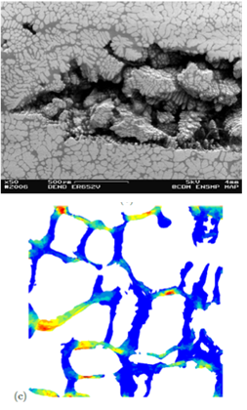
Why is DVC important ?
MACRO
MICRO
Fine scale
Heterogeneous strain/stress effects
Homogeneous solids under complex loads
In situ 3D imaging + Digital Volume Correlation: EXPERIMENTAL 3D displacements and strains

Slide 6
History of DVC

Slide 7
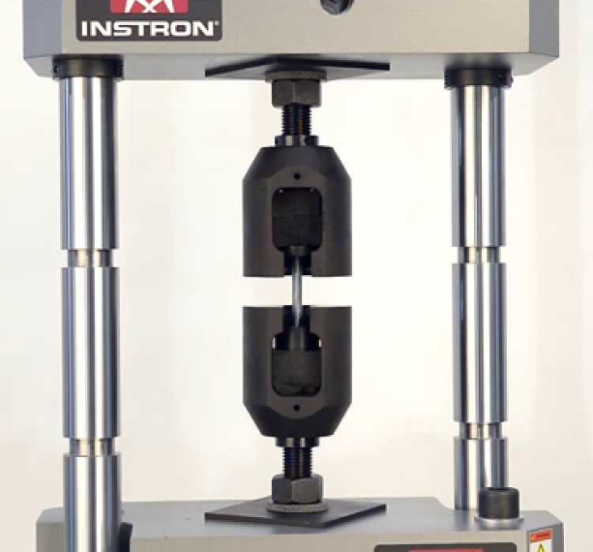
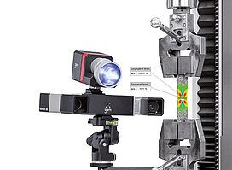
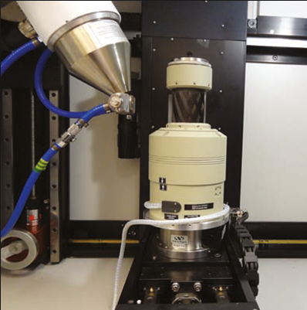
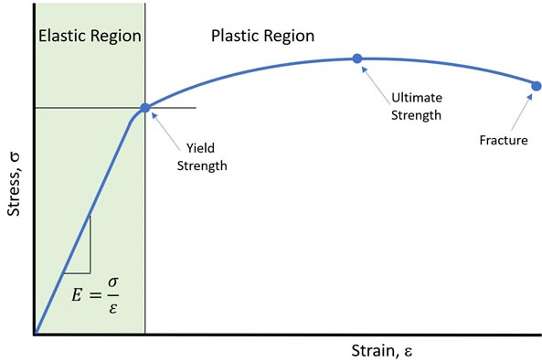
History : Technique evolution
Traditionnal mechanical testing :
Pros:
-fast and easy to setup
Cons:
-macroscopic response
-Single value for the associated strain
-doesn’t reflect the heterogeneous nature of materials
Mechanical testing + 2D/3D DIC :
Pros:
-fast, easy to setup and non-destructive
-Capture material heterogeneit
-True stress-strain curves
Cons:
-2D surface measurements do not always reflect the bulk mechanical behaviour of complex materials
-Painted surface so no direct link to microstructure
Mechanical testing + DVC:
Pros:
-Non destructive
-True stress-strain curves
-Capture material heterogeneity in real time and in 3D (in situ)
-Direct link with microstructure
Cons:
-Expensive
-In situ imaging not easy to setup
-DVC relies on the natural contrast of the material

Slide 8
Digital Image Correlation
First publication in 83 [Sutton et al.]
Inspired from Particle Image Velocimetry

Slide 9
Digital Image Correlation - developments
Surface 3D (~1990’s)
Volume 3D = DVC (~2000’s)
2D (~1980’s)

Slide 10
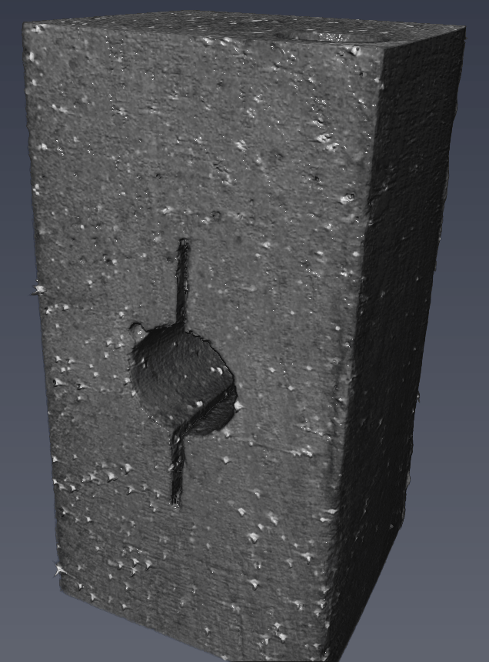
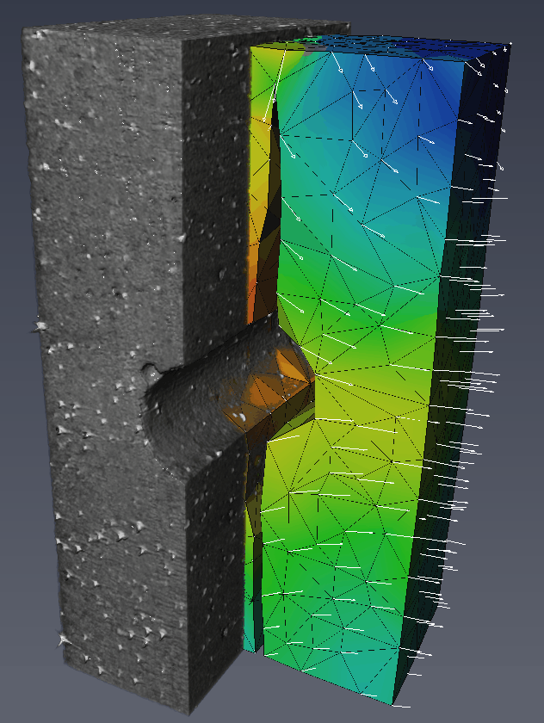
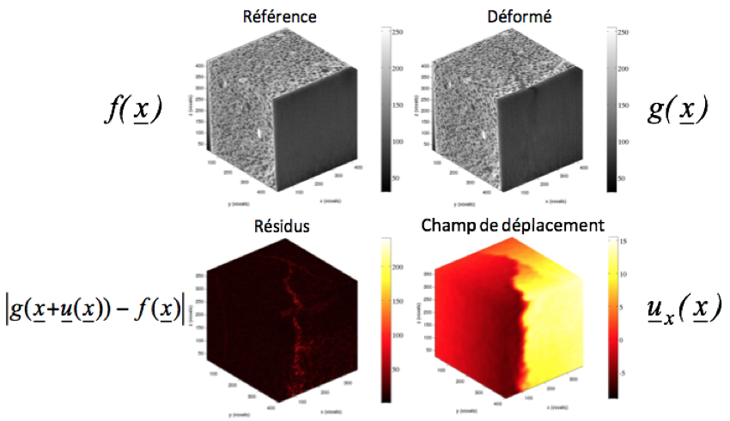
Digital Volume Correlation
A technique to measure displacements… and compute strains
DCDC fracture test
Example: DCDC fracture test
Example : test of a plasterboard [Bouterf et al., 14]
Jailin et al., 2017

Slide 11
How DVC works?

Slide 12
1) Intro to Image Correlation

Slide 13
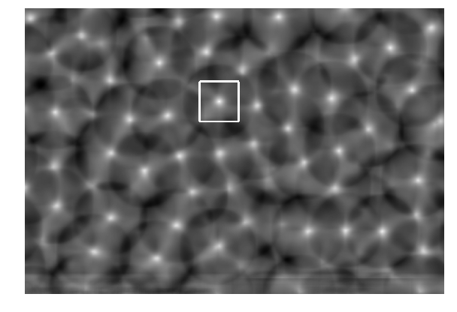
Template Matching
Cross-correlation
Correlation Coefficient can be computed in many different ways (normalized or not,…)
Zones of high correlation correspond to the best local match between the image data and the template

Slide 14
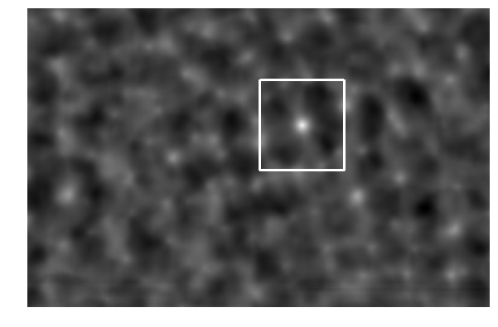
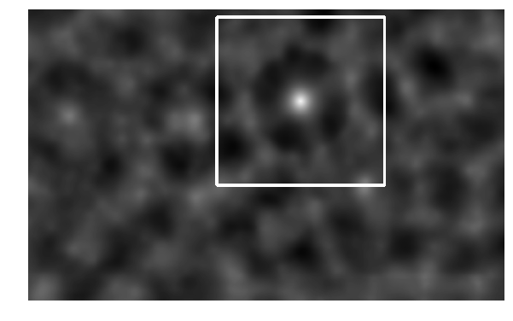
Image Correlation
Cross-correlation

Slide 15
2) DVC Approaches

Slide 16
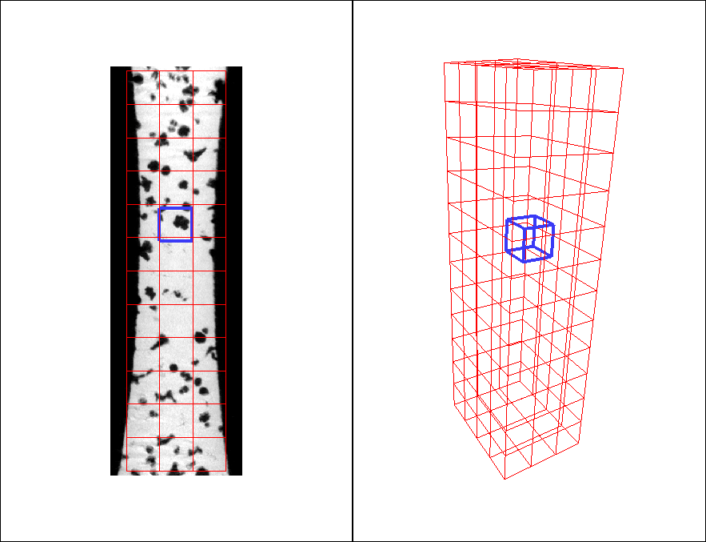
Local Approach
Iterative process
Difficult to capture complex shapes
Disp. continuity not satisfied
Visualisation and quantification are limited
Need to save large amount of data (images)
Digital Volume Correlation: local approach

Slide 17
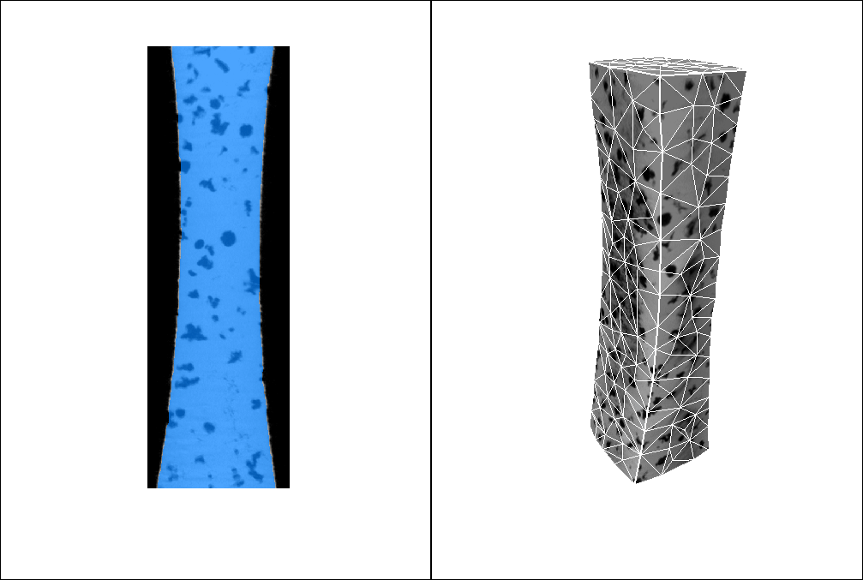
Global Approach
Flexible meshing to capture complex shapes (tetrahedra)
Global FE approach: disp. continuity satisfied
Local and global combined
Memory efficient (data stored in meshes)

Slide 18
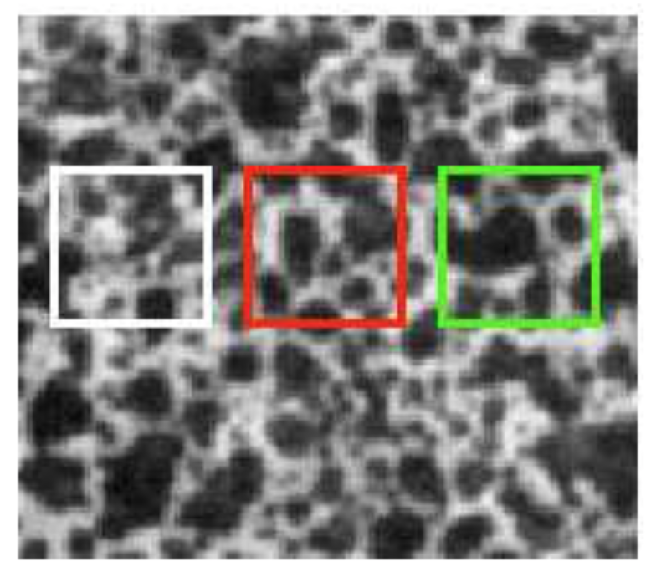
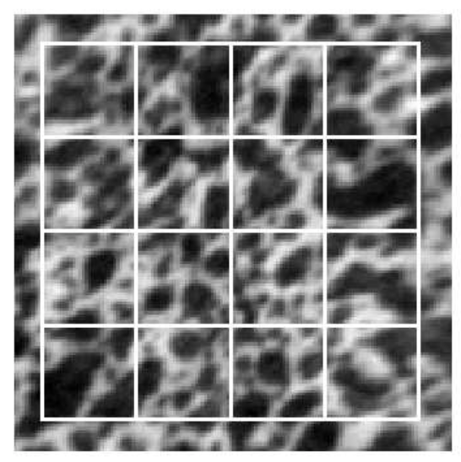
DVC technical terms: contrast, spatial resolution
Subset size
Contrast/Texture: random pattern produced by changes in local contrast (tracking features)
Element size
Spatial resolution: length scale at which the displacements are evaluated
Local: cubic root of the mean volume of local subset
Global: cubic root of the mean number of voxels (volume) considered for the nodal displacement measurement

Slide 19
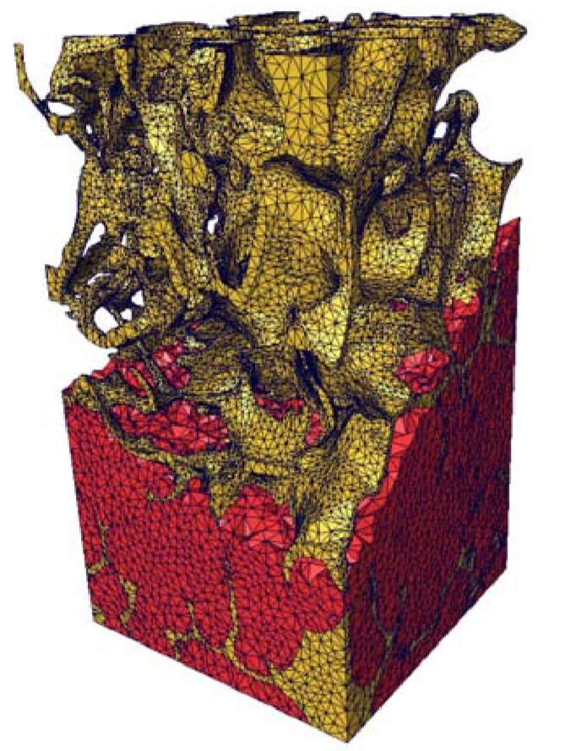
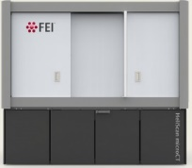
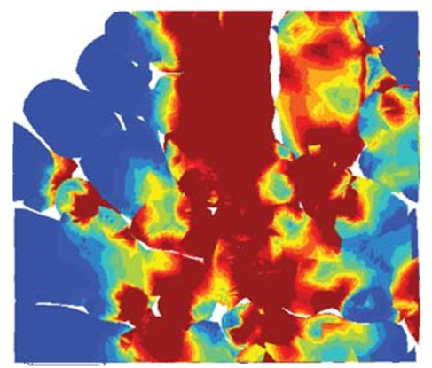
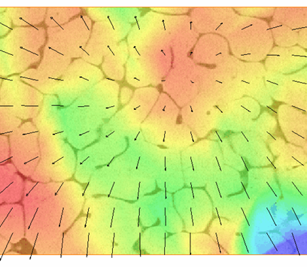
Avizo® Digital Volume Correlation
Multimodal 3D image import
Image processing
2D and 3D visualization
Advanced segmentation
Surface mesh generation
Tetrahedral mesh generation
Export to FE and CFD software
Digital Volume Correlation: Compute 3D full-field displacements and strains and bridge the gap between experiments and simulations
SEGMENTATION
3D EXPLORATION
MEASUREMENTS & ANALYSIS
Avizo
3D MESHING
IMAGE PROCESSING
EXPORT TO FE
RAW IMAGES
DATA ACQUISITION
DIGITAL VOLUME CORRELATION

Slide 20
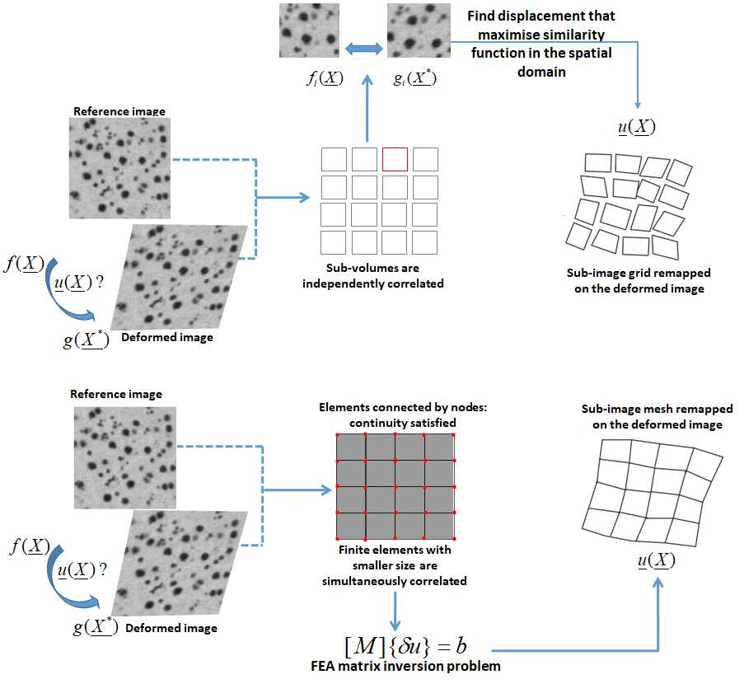
Avizo® Digital Volume Correlation
2x DVC solutions implemented
“Classic“ subset based local approach using local cross-correlation in the spatial domain
Finite element-based global approach*
*ROUX, S., HILD, F., VIOT, P., BERNARD, D. Three dimensional image correlation from X-Ray computed tomography of solid foam. Composites Part A/Applied Science & Manufacturing. Vol 39. Num 8. Pages 1253-1265. 2008

Slide 21
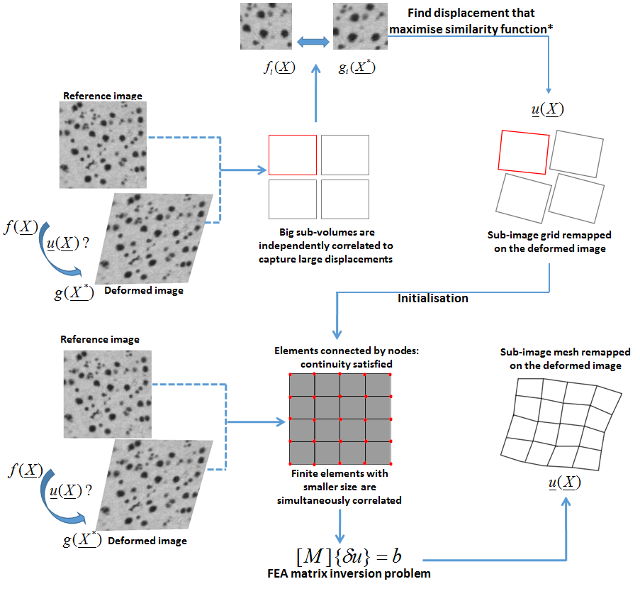
Avizo® Digital Volume Correlation
2 step workflow in Avizo
Starting with the (faster) local approach
Using the results from the local approach to initialize the FE based global computation

Slide 22
Critical parameters to consider when looking at DVC dataset
1. Microstructure (not controlled):
2. Specimen geometry (not controlled)

Slide 23
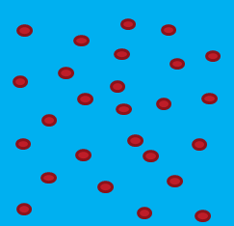
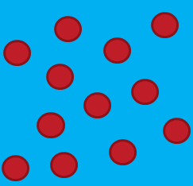
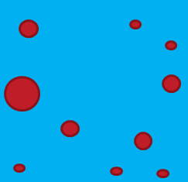
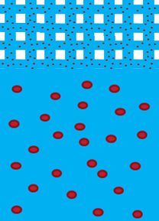
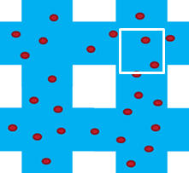
Critical parameters to consider when looking at DVC dataset
subset
3-4L
subset
1. Microstructure (not controlled):
Randomness
Homogeneity
Length scale, subset/element size
Solid/Cellular
Single material, multiphase material
3-4L
L
L
L
3-4L
T
Subset size ~ T

Slide 24
Critical parameters to consider when looking at DVC dataset
2. Specimen geometry (not controlled):
Shape: regular, non regular
Dimensions (isotropy/anisotropy, thin specimens)
non regular
regular
non regular
Local
Global
Global
Global

Slide 25
Meshing for global DVC
Case study :
Tensile specimen with typical “Dog-bone” shape → Global approach better to fit shape
Texture → Created by dark inclusions (graphite nodules) in the main cast-iron matrix
The Global mesh needs to fit the sample and contain both the matrix and the inclusions.
The size of the elements must be adapted to the typical size of the microstructure (linked to distance between inclusions)

Slide 26
Case Study #1 : Tensile Test Generation of Global DVC mesh

Slide 27
Load/Inspect data
Load
Change orientation to “XZ” in Orthoslice
Create “ColorWash” on “Orthoslice”
Right click on “Orthoslice”
Link second dataset in “Colorwash” Data Port
Adjust “Slice number” in “Orthoslice” and “Weight Factor” in “ColorWash”
Click and drag on the link between “ColorWash” and “Deformed3”, then drop it on another Deformed image

Slide 28
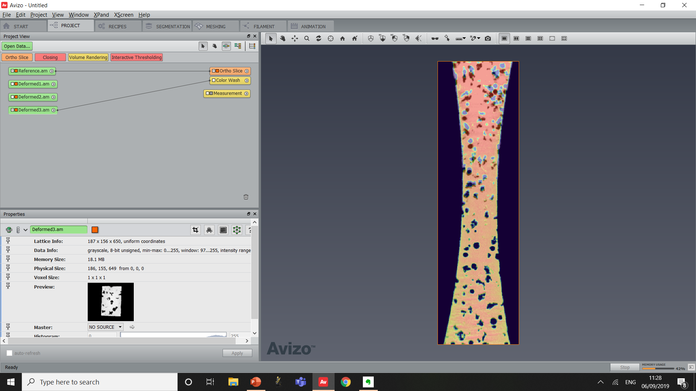
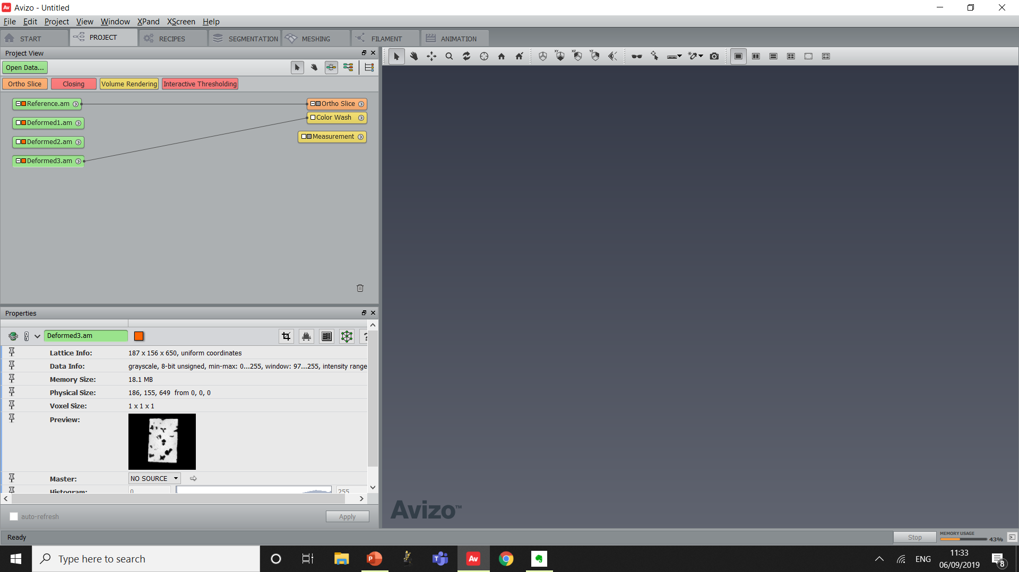
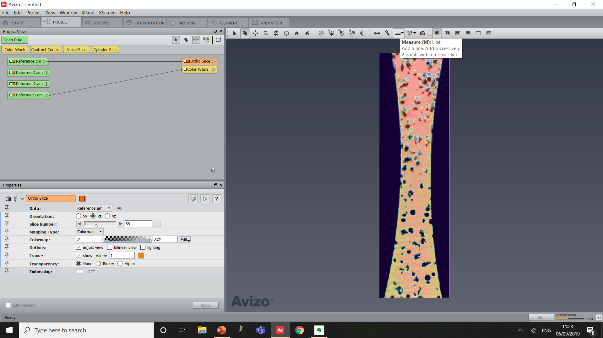
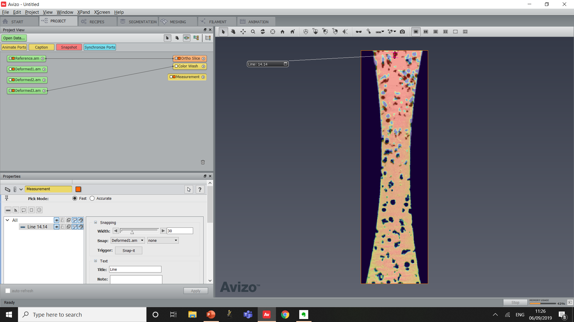
Max Displacement Estimation :
Set Slice Number to 55
Measure Max Displacement in the Top Region of the dataset
Observe a Maximum Displacement of around 15 Voxels
Once finished, deactivate “Measurement” by clicking on the Orange square next to the name
Turn On/Off the Orthoslice by also clicking the Orange square

Slide 29
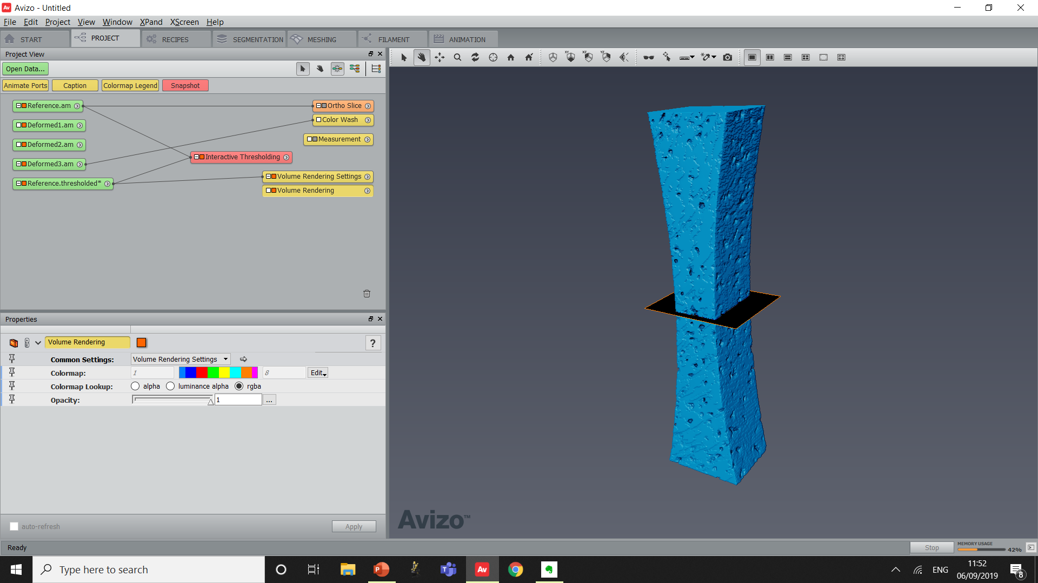
Matrix segmentation :
Create “Interactive Thresholding” on the Reference image
Set Minimum of Intensity Range to 80
Click Apply
Create a Volume Rendering Module
Binary Mask of the Cast Iron matrix
Is this suitable for a DVC mesh?

Slide 30
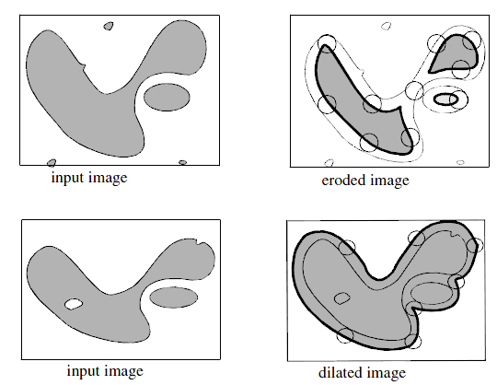
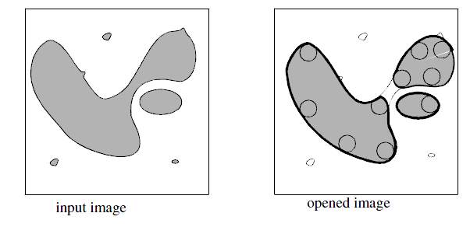
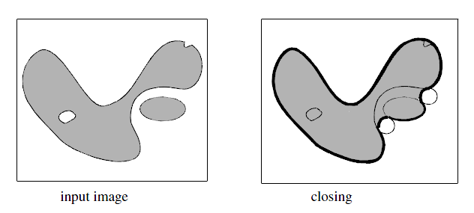
Side Note : Mathematical Morphology
Erosion/Dilation :
Opening/Closing :
Opening=Erosion+Dilation
Closing=Dilation+Erosion

Slide 31
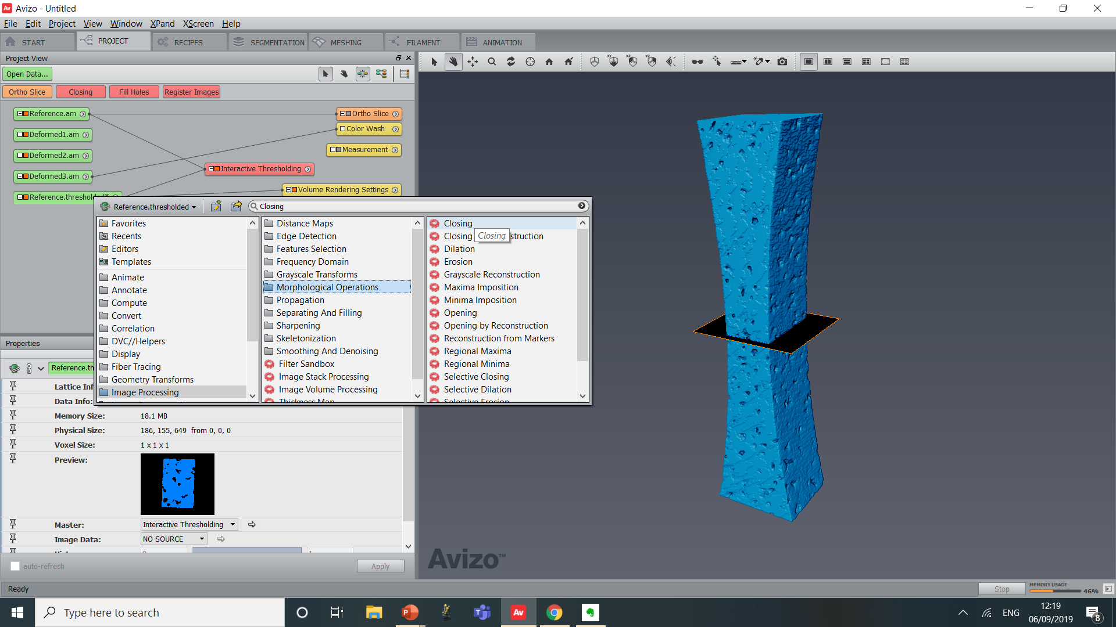
Object mask :
Create a “Closing” module on the result of the “Interactive Thresholding”
Set the size of Closing to 6
Click Apply
Slide the Volume Rendering on the resulting image
Binary Mask of all phases of the sample
Ready for DVC mesh preparation

Slide 32
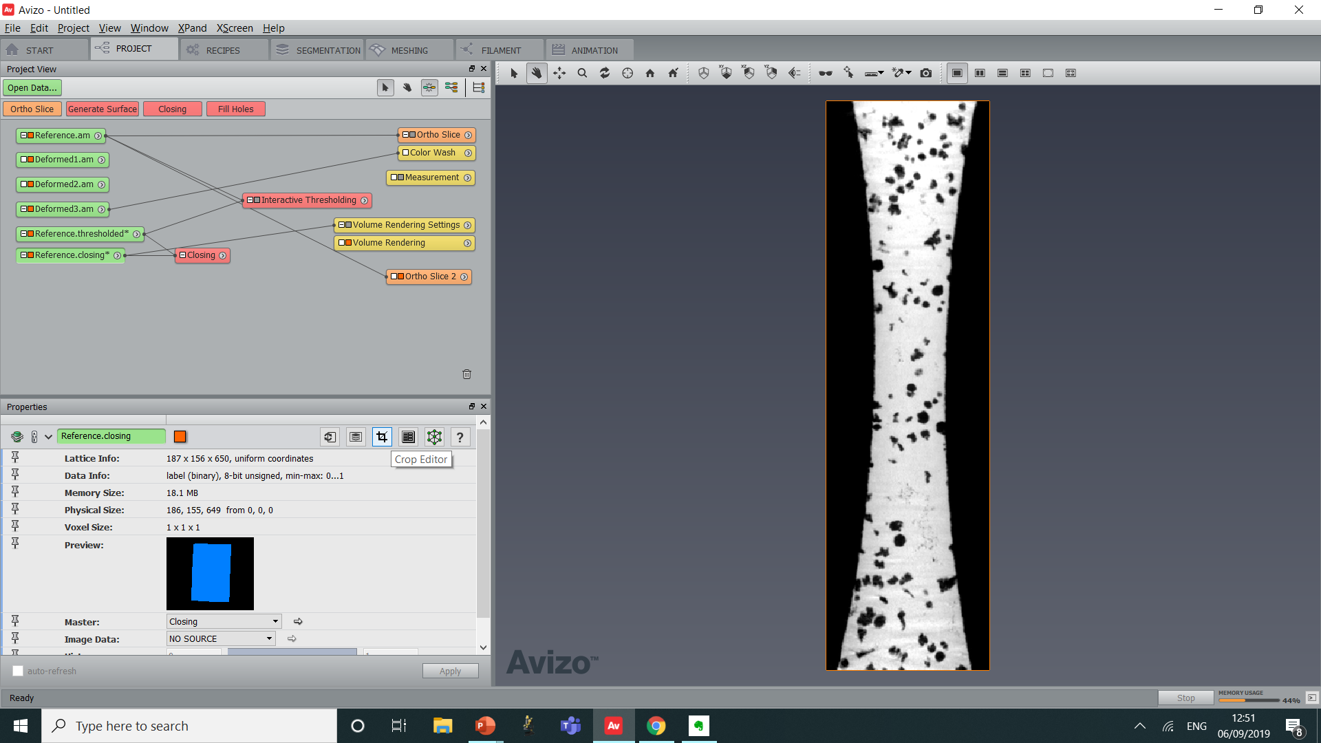
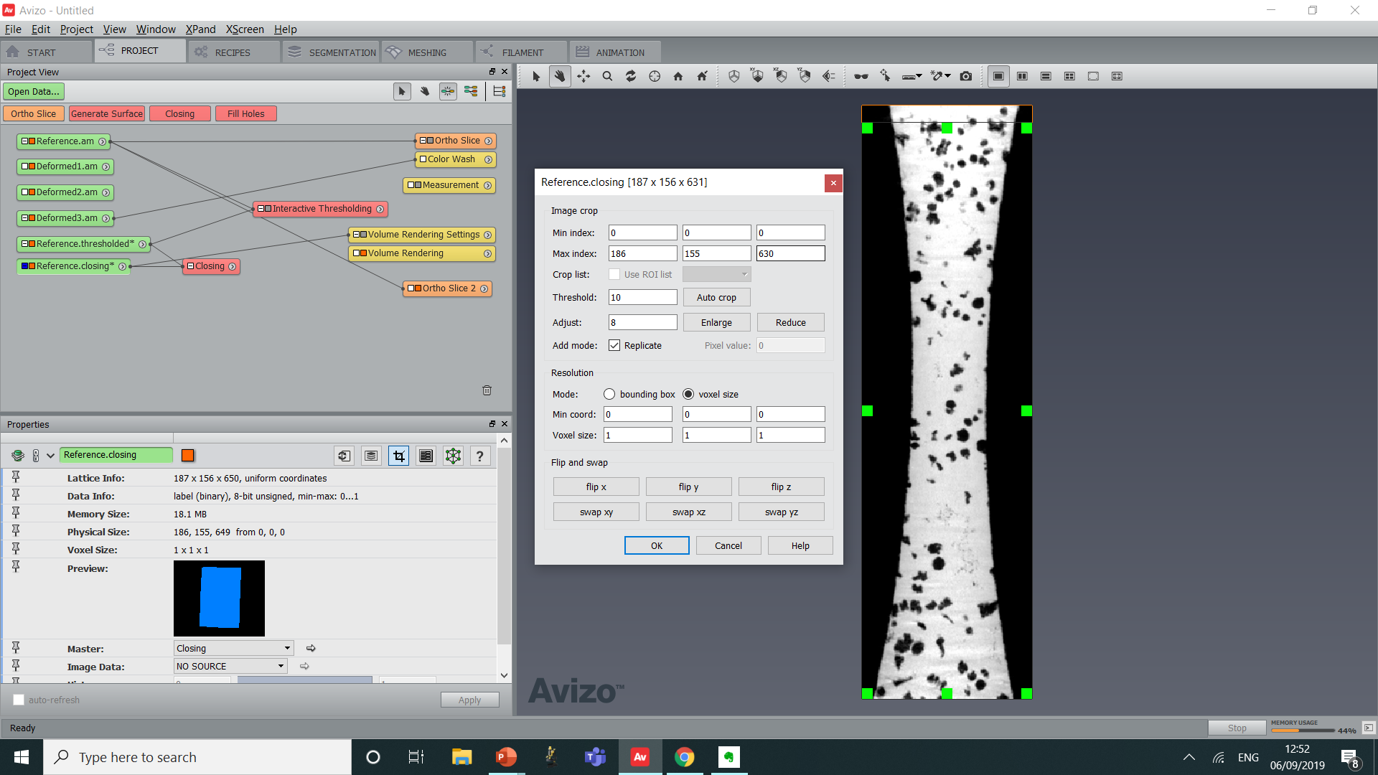
Object mask :
From first observations, the maximum displacement at the top is about 15 voxels
Activate the Crop Editor
Set the max Z to 630
Click on “OK”

Slide 33
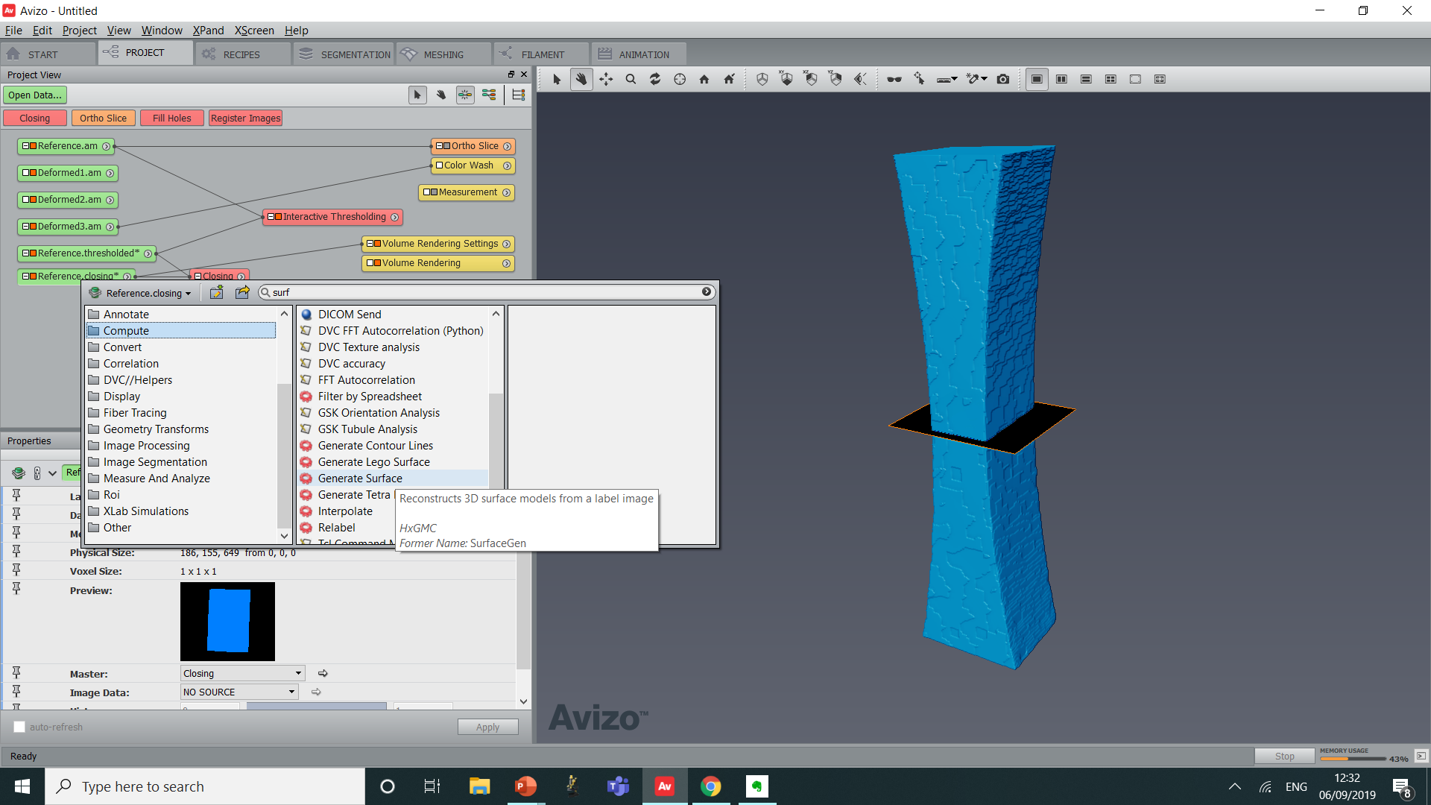
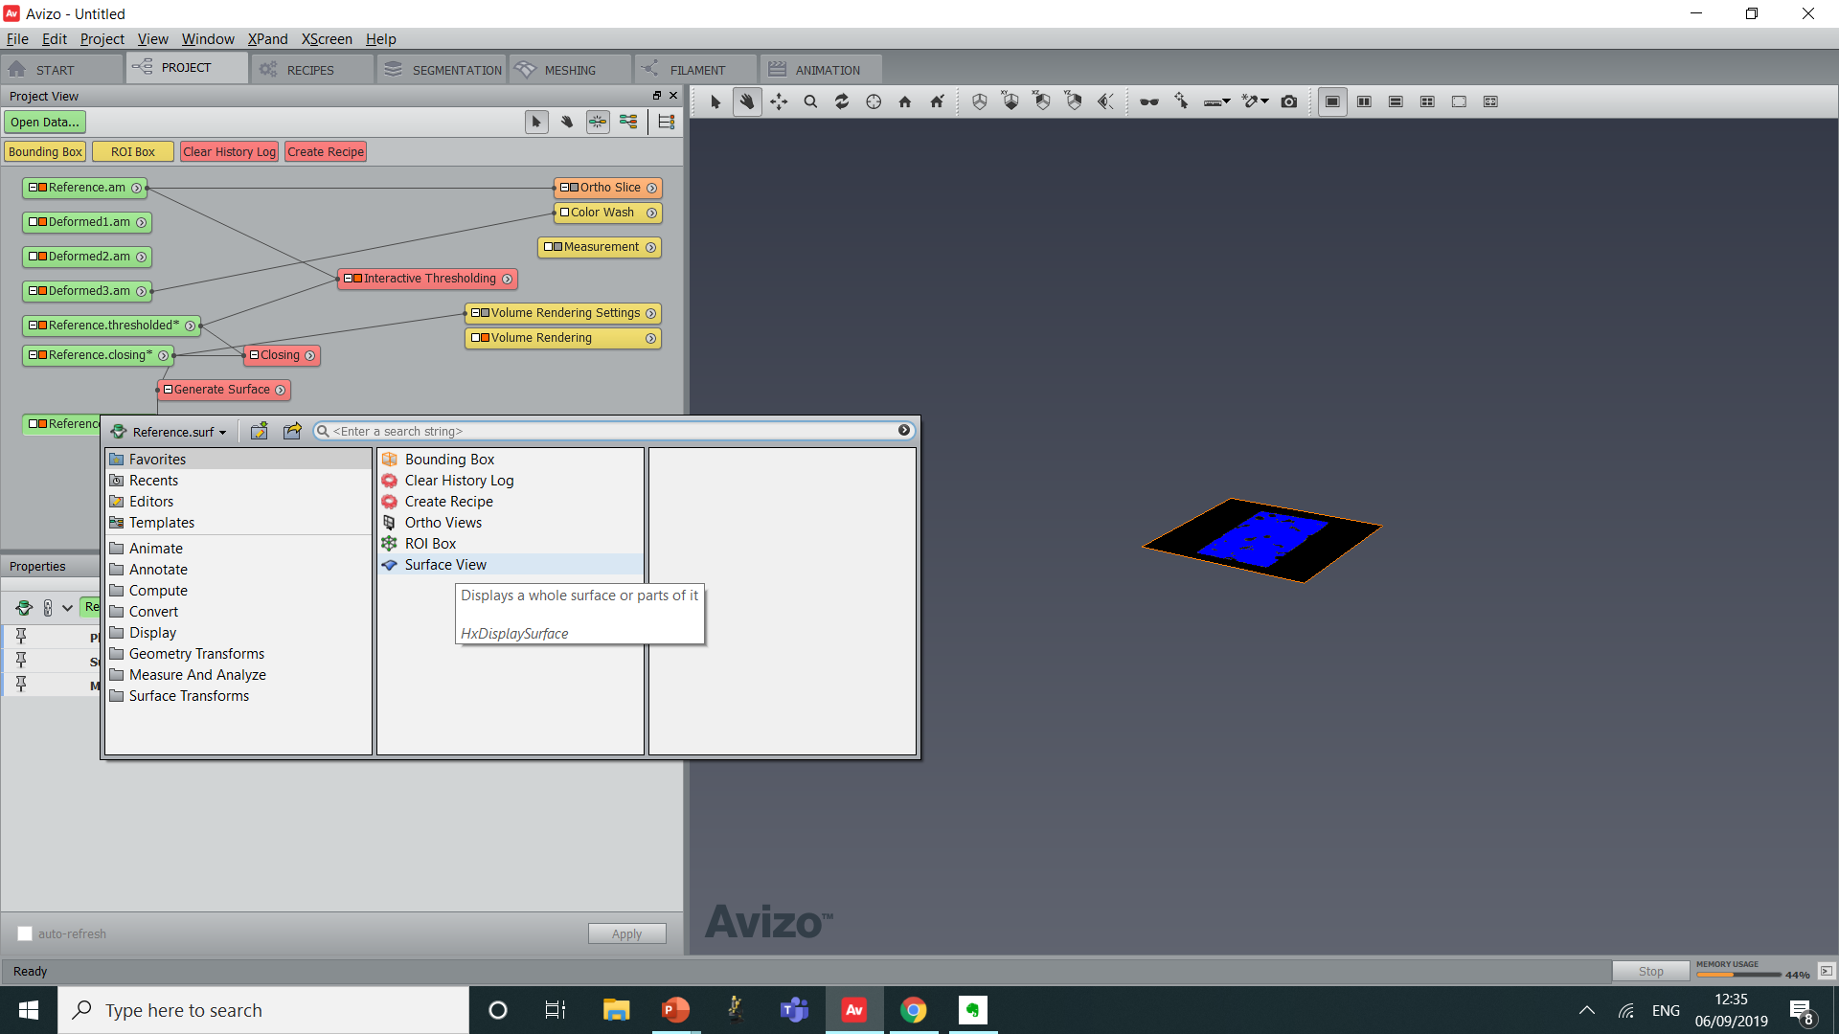
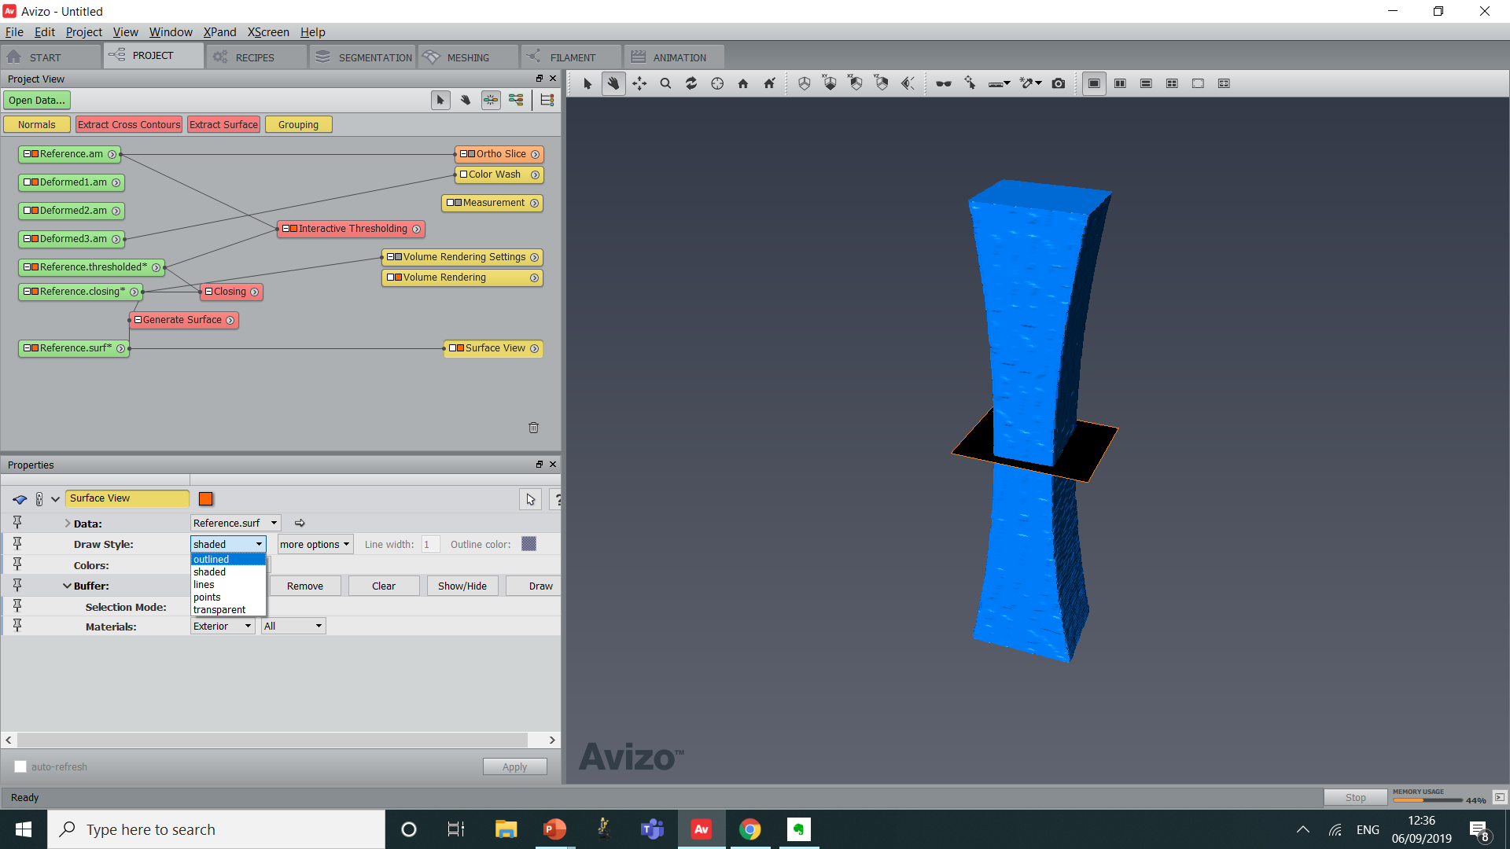
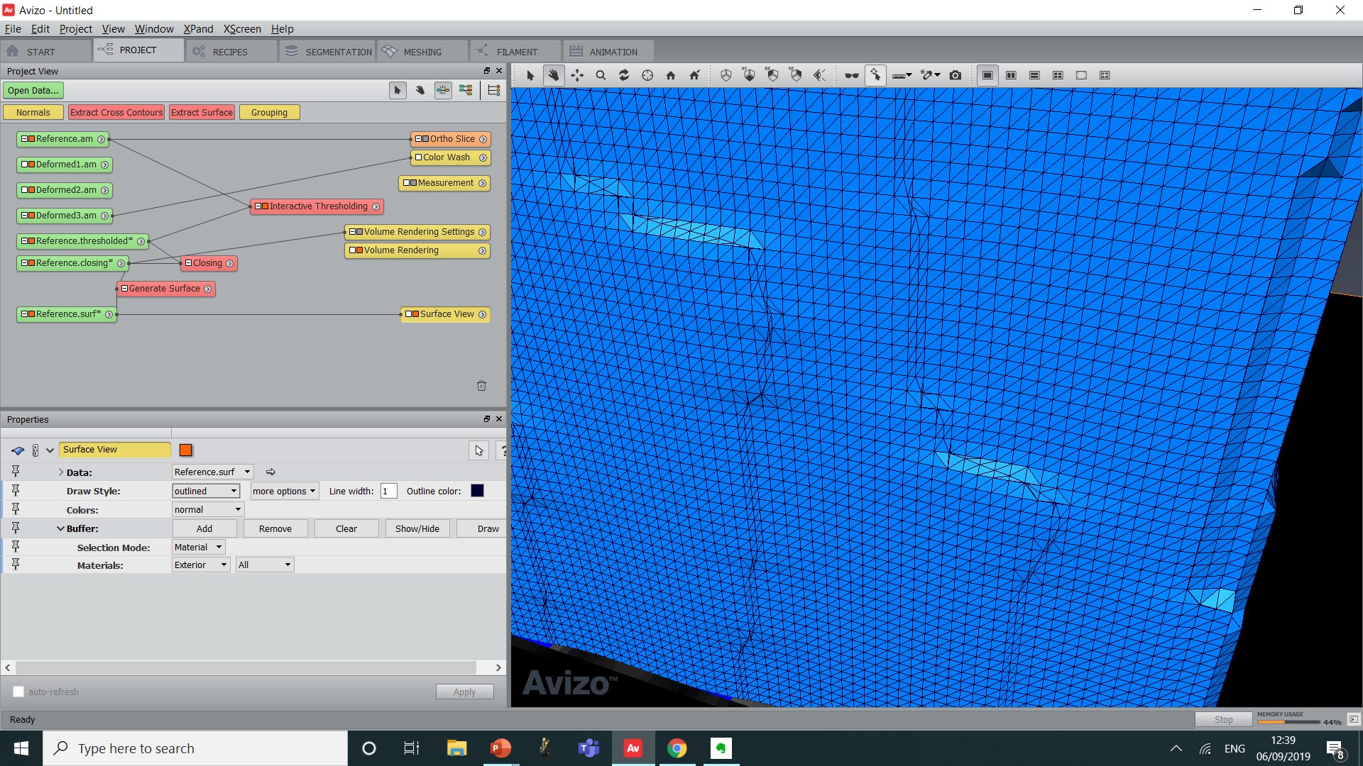
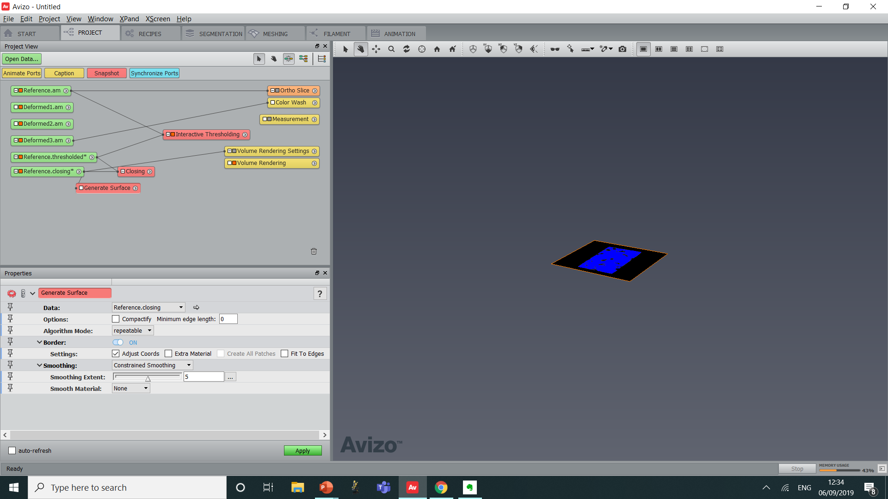
Surface skin generation :
Create a “Generate Surface” module on the result of the “Closing”
Set Smoothing to “Constrained Smoothing”
Click Apply
Create a “Surface View” module
Set the Draw Style to “Outlined”
Zoom in to observe the elements
Comment on the size of the elements
Suitable for DVC ?

Slide 34
Side-Note : Suitable Size of elements for DVC
Too Small : Not enough information in small elements
Getting too large : 1 element in places
The size of elements must be adjusted to fit the “texture” of the material (matrix and inclusions)
Small elements : better resolved but lower accuracy
Large elements : Better accuracy but not well resolved

Slide 35
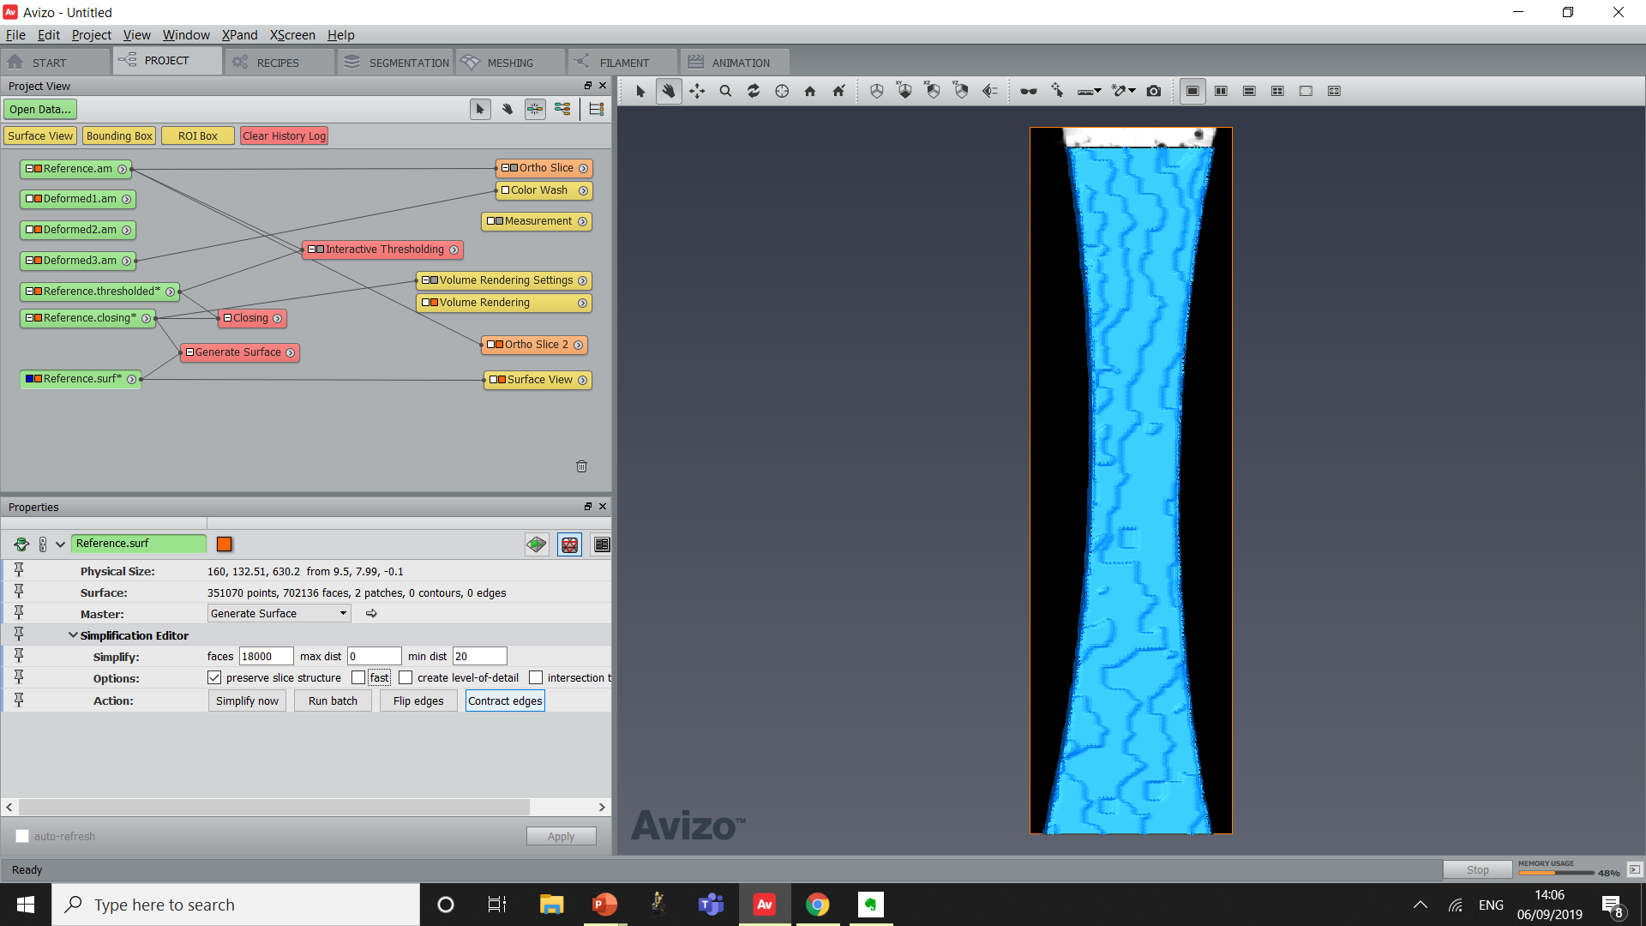
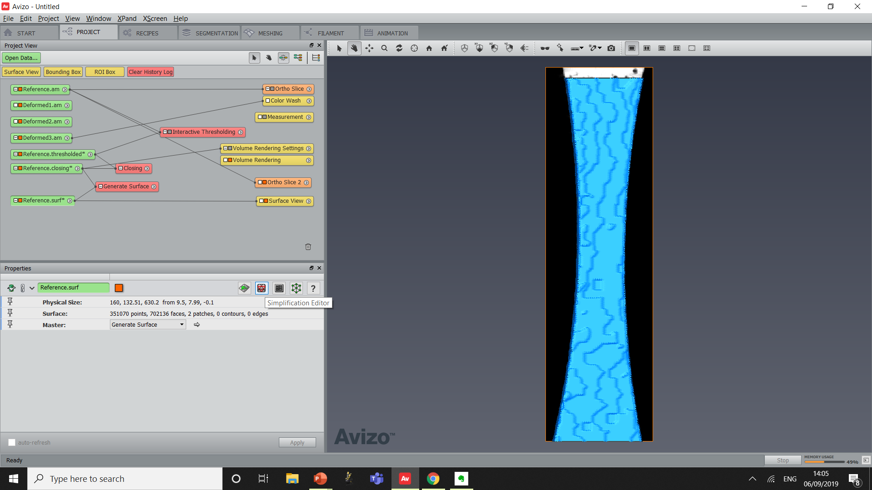
Surface simplification :
Select “Reference.surf”
Activate the Simplification Editor
Set the Min Distance to 35
Tick “Preserve Slice Structure”
Click “Contract Edges”
In Surface View, set Draw Style to Lines

Slide 36
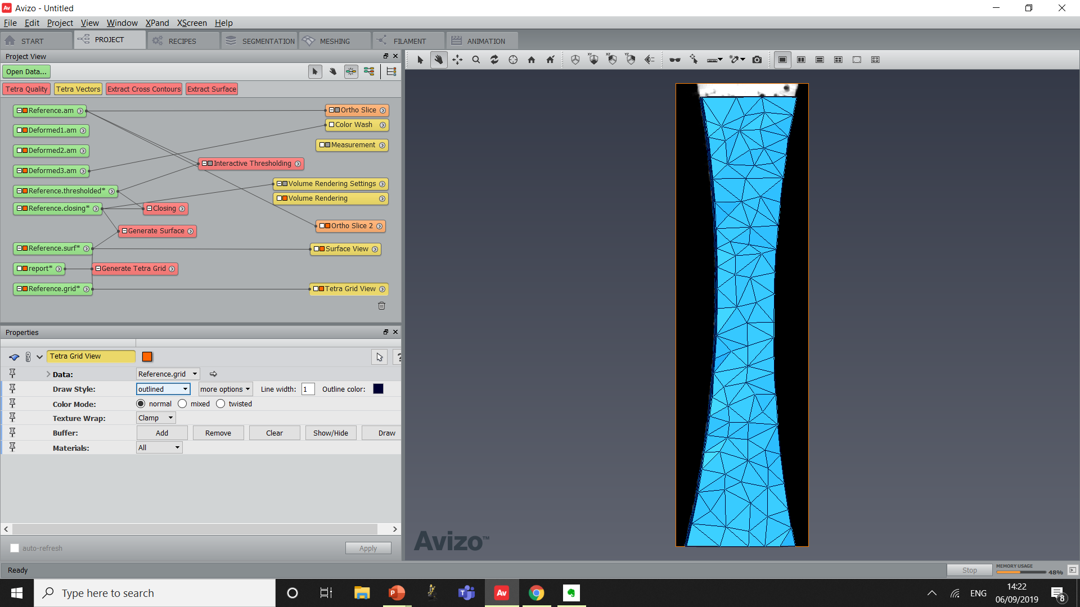
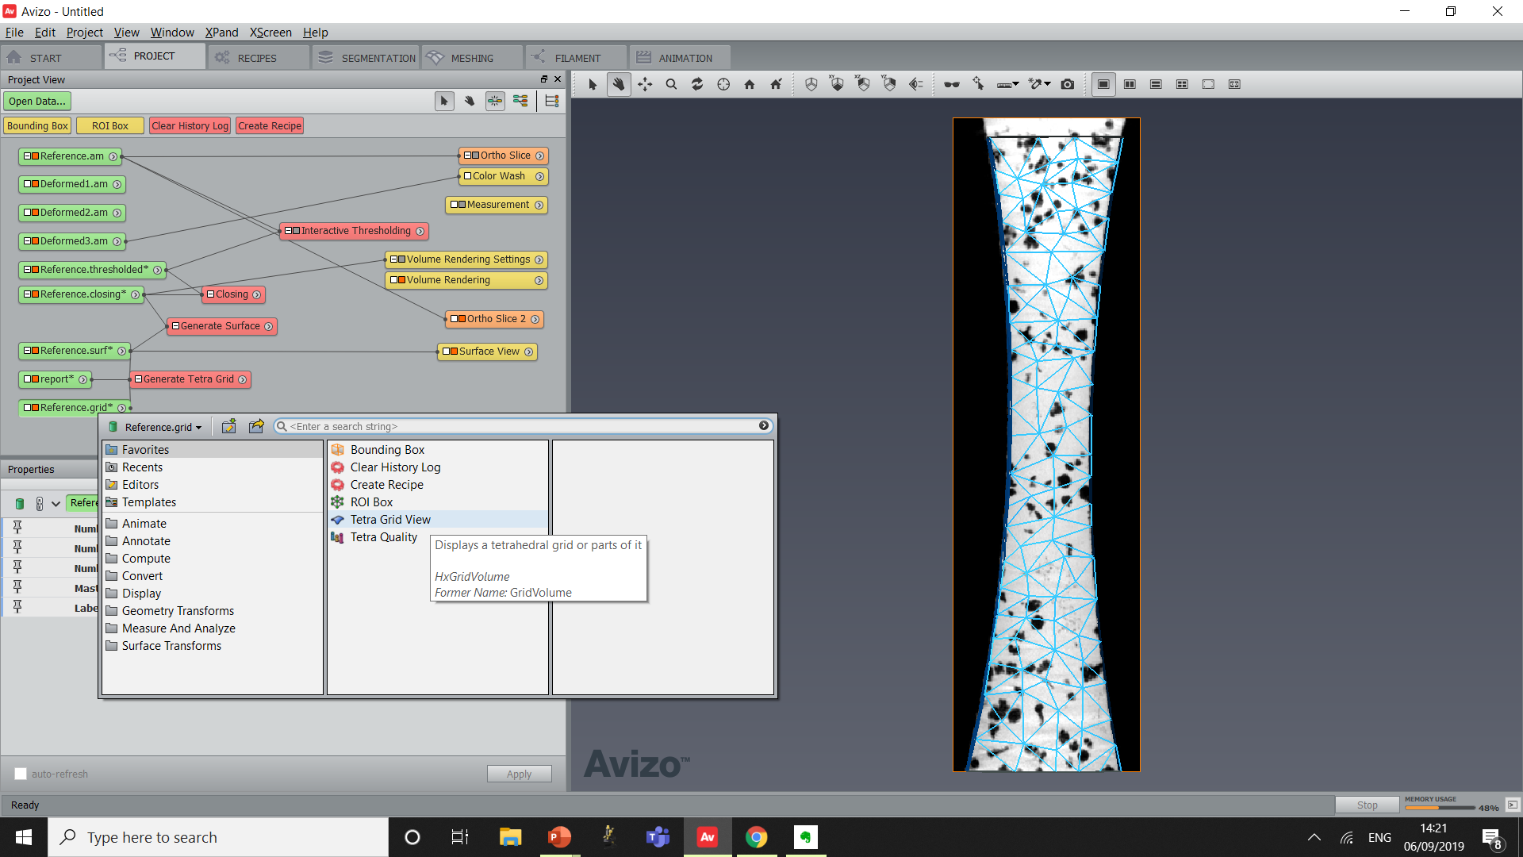
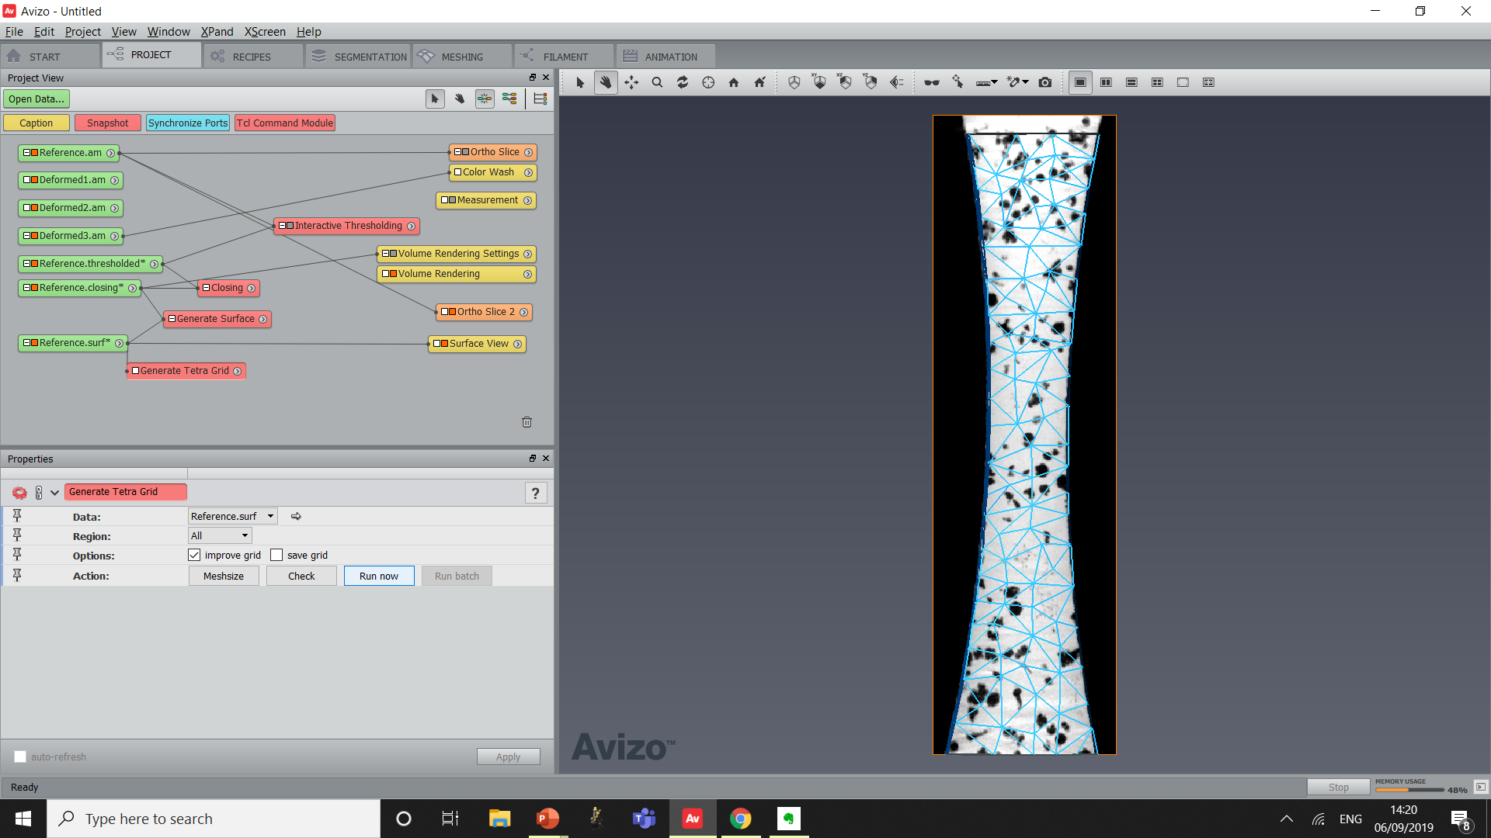
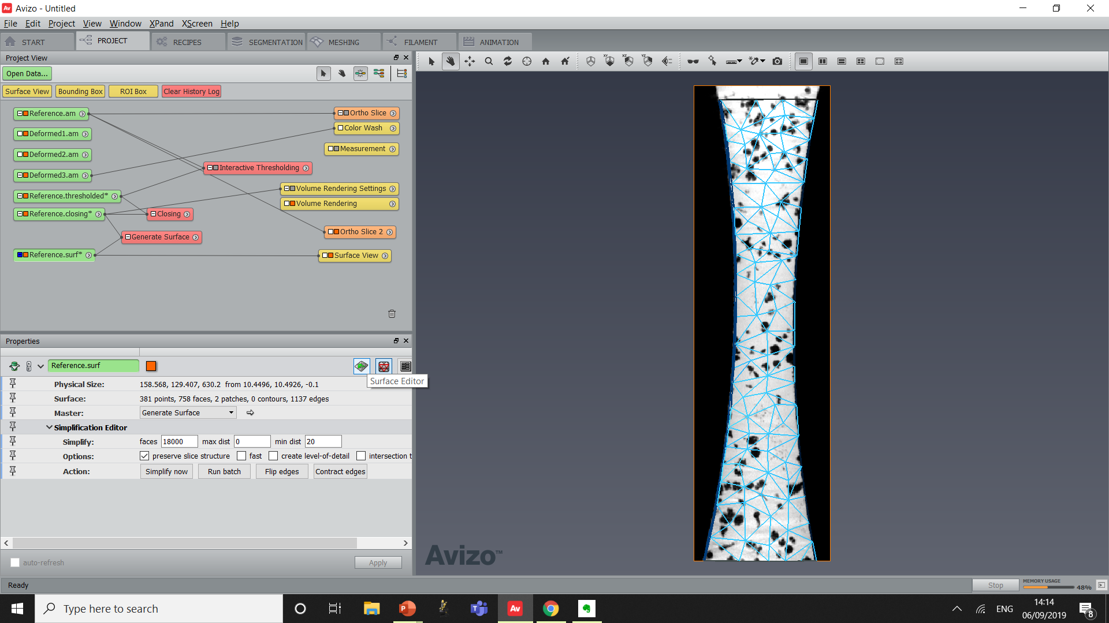
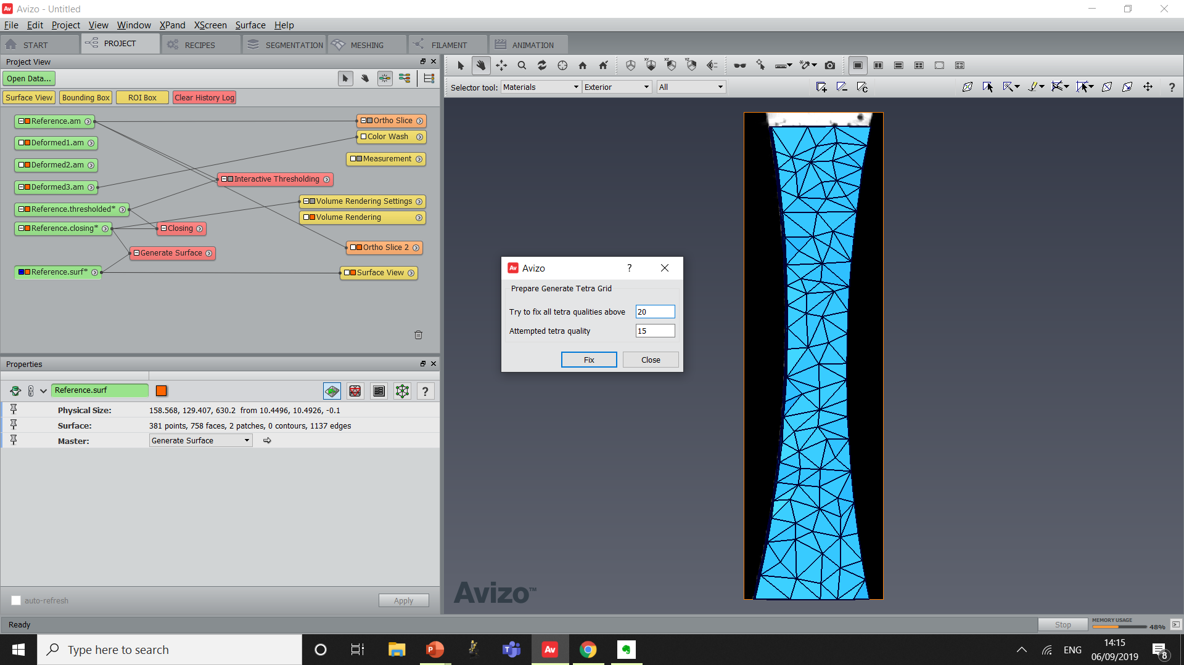
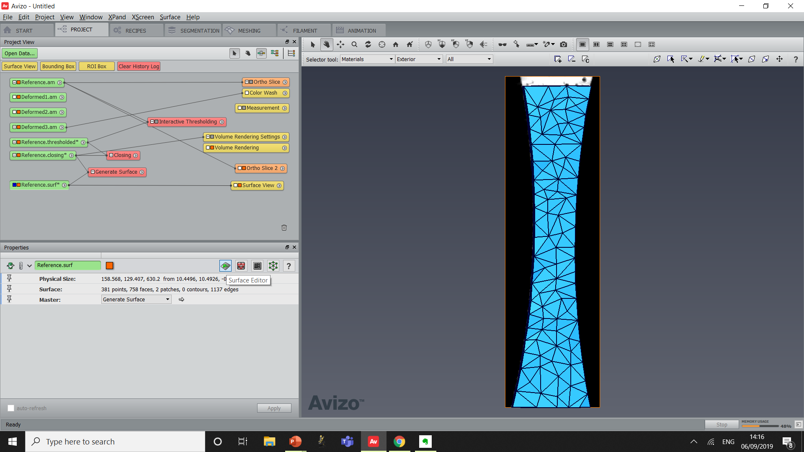
Surface check and Volume Mesh:
Activate the surface Editor
Go click on “Surface/Edit/Prepare Generate Tetra Grid”
Click Fix
Then Close
Deactivate Surface Editor
Create “Generate Tetra Grid”
Click “Run Now”
Create “Tetra Grid View” on the .grid result
Set Draw Style to Outlined

Slide 37
Mesh is ready :
Save mesh in Avizo Format

Slide 38
Case Study #1 : Tensile Test DVC Computation

Slide 39
DVC Computation :
Create a “Global-Iterative” module (from DVC/Helpers)
Link dataset as shown here and set parameters
Click Apply
Results :
Displacement and strain field from Reference to Deformed 1
Displacement and strain field from Reference to Deformed2
Displacement and strain field from Reference to Deformed3

Slide 40
DVC Check :
Check the convergence of the global algorithm by opening the console
3 DVC computations were done and have all converged to <0.001
Sign that the solution was found correctly
Global approach also enables the use of a “Residual Image” which will highlight areas that have not correlated well (discontinuities, change in texture through time, etc…)

Slide 41
Case Study #1 : Tensile Test Visualisation of Results

Slide 42
Tools for visualisation :
“DVC Disp View” on a “.disp” field
“ColorWash” : Create an “Orthoslice” module on Reference, then a “ColorWash” on the “Orthoslice” and select a “Magnitude” field in the data port
“DVC Scalar Extract” on “.strain”
Tick “VonMises” or “E1”
Click Apply

Slide 43
Go through the results :
Spend some time trying to display the results of the 3 DVC computations
Extra : Link to microstructure

Slide 44
Case Study #1 : Tensile Test Boundary Conditions Export To FE

Slide 45
Extract DVC boundary conditions

Slide 46
DVC-FE direct comparison: Uz
Difference between experiments and simulation

Slide 47
DVC-FE direct comparison: e33

Slide 48
Towards identification of material properties
Run FE
Levenberg-Marquardt
Optimization: find material parameters (E, mu, K, n, etc.) that minimize FE-DVC displacement maps and macroscopic FE-Exp force-displacement curve
F
U
Direct comparison with experiment
FE solution

Slide 49
Case study 2 : Adaptive DVC approach applied to augmented vertebral bodies

Slide 50
Vertebroplasty
Minimally invasive procedure to treat vertebral compression fractures as a result of osteoporosis, cancer (myeloma), or trauma
>1.4M vertberal fractures are estimated to occur every year worldwide (i.e. 1 fracture every 23 seconds)
Yearly cost for osteoporotic fractures in the spine ~ €719M in Europe only
Strong but controversial concern: occurence of fractures in adjacent vertebrae due to the increased stiffness of the augmented vertebrae
Healthbase.com
Cement injection
University of Portsmouth by Dr Gianluca Tozzi and his team
In situ experiments coupled with DVC →
Investigate the deformation and damage mechanisms
Optimal cement material and filling volume
Identify the mechanical properties of the cement using 3D full-field measurements
Kanis JA, Johnell O. Requirements for DXA for the management of osteoporosis in Europe. Osteoporos Int 2005;16(3):229e38.
Johnell O, Kanis JA. An estimate of the worldwide prevalence and disability associated with osteoporotic fractures. Osteoporos Int 2006;17(12):1726e33.

Slide 51
DVC of multiphase materials
Local length scale mapped in subvolumes of size 48 voxels
Multiphase materials are complex systems where different textures with different length scales interact mechanically
Interfaces have strong variations of texture
Adaptive meshing informed by texture could bridge this gap

Slide 52
Local characteristic length scale over the whole sample
Cement: length scale ~ 6 voxels
Bone/cement interface: length scale ~ 18-25 voxels
bone
interface
cement
Trabecular bone: length scale ~ 8 voxels
Injected cement region: length scale ~ 6-15 voxels
Injected zone

Slide 53
Adaptive meshing
bone
Interface
cement
Adaptive mesh: tuned spatial resolution and lower/constant uncertainty in bone, cement, interface and injected cement region
Injected zone
Displacement ~ 0.07 voxel
Strain ~ 0.2-0.3%

Slide 54
Assess the efficacy and safety of vertebroplasty
Injection of third of total vertebral volume cement
Injection of half of total vertebral volume cement
Acrylic cement injection
Smooth strain transfer
Strong strain localisation

Slide 55
Summary

Slide 56
Amira-Avizo® software for Digital Volume Correlation :
Flexible meshing to capture complex shapes (tetrahedra)
Global FE approach: disp. continuity satisfied
Local and global combined
Memory efficient (data stored in meshes)
Visualize displacements and strains in a click
Link the DVC results to the microstructure using advanced quantification
Export DVC mesh and DVC boundary conditions to FE software packages

Slide 57
Extras

Slide 58
Critical parameters to consider when looking at DVC dataset
3. Measurement uncertainties (trade-off):
Most of the time, CT artefacts control the DVC accuracy
2 ways to measure uncertainty levels:
Repeated scan (bis)
Rigid body motion (rbm)
Buljac et al., Digital Volume Correlation: Review of Progress and Challenges. Exp Mech 2018

Slide 59
Critical parameters to consider when looking at DVC dataset
4. Loading (can be controlled):
Regime and number of steps: what regime needs to be captured ? Elastic regime, plastic regime, damage, … everything?
Displacement magnitude: small displacements between steps (rule of thumb: ¼ of subset size maximum)
regime3
5
2. rigid body motion suppressed: good correlation
compression
regime2
subset
compression + rigid body motion
regime1
0
Good strategy:
-local initialisation + global
-Coarse registration
1. bad correlation: too far away

Slide 60
Critical parameters to consider when looking at DVC dataset
4. Loading (can be controlled):
Strategy for in-situ (see figure on the right) should be chosen depending on material relaxation, scan time, deformation rate
Scan time : Over the duration of 1 scan, movement should be less than 1-2 voxels ideally, to avoid motion blurring
For DVC to work reliably (conservation of texture), amount of deformation between 2 consecutive scans should be reasonably small (vs the intended subvolume size)

Slide 61
Overview of Avizo XDigitalVolumeCorrelation
Local approach
Anisotropic subset size: useful when dealing with non regular geometries, anisotropic structures or displacements

Slide 62
Overview of Avizo XDigitalVolumeCorrelation
By default, max displacement is set to ¼ of the subset size to help convergence. Advice: use small displacement steps during your in situ experiments)
Correlation filter : useful for initialising the global approach but check carefully the vectors quality
Local approach
Translation + Rotation: fast and efficient when combined with global-DVC
Translation + Rotation + Shear: slower but useful to provide a better guess for complex problems

Slide 63
Overview of Avizo XDigitalVolumeCorrelation
3D meshing:
Regular dataset: use the Mesh Generation module
Complex objects: Generate Tetra Meshes directly in Avizo or import from other software
Global approach

Slide 64
Overview of Avizo XDigitalVolumeCorrelation
Reference mesh: choose a good mask that match the exact shape while avoiding the edges in contact with the background
Global approach
Anisotropic subset size: useful when dealing with non regular geometries or anisotropic structures
Initialisation: possible to initialize with local or global displacements

