Slide 1



X-ray CT and IBFEM to inform the additive manufacture process
EBM of Ti-6Al-4V
S Tammas-Williams
F Derguti, F Leonard, PB Prangnell, I Todd, PJ Withers, H Zhao
5th September 2018

Slide 2
Fatigue crack initiation mainly from pores

Slide 3
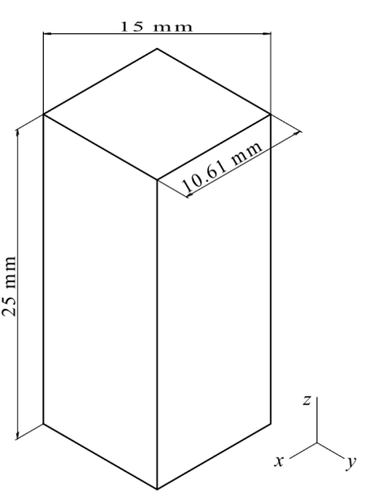
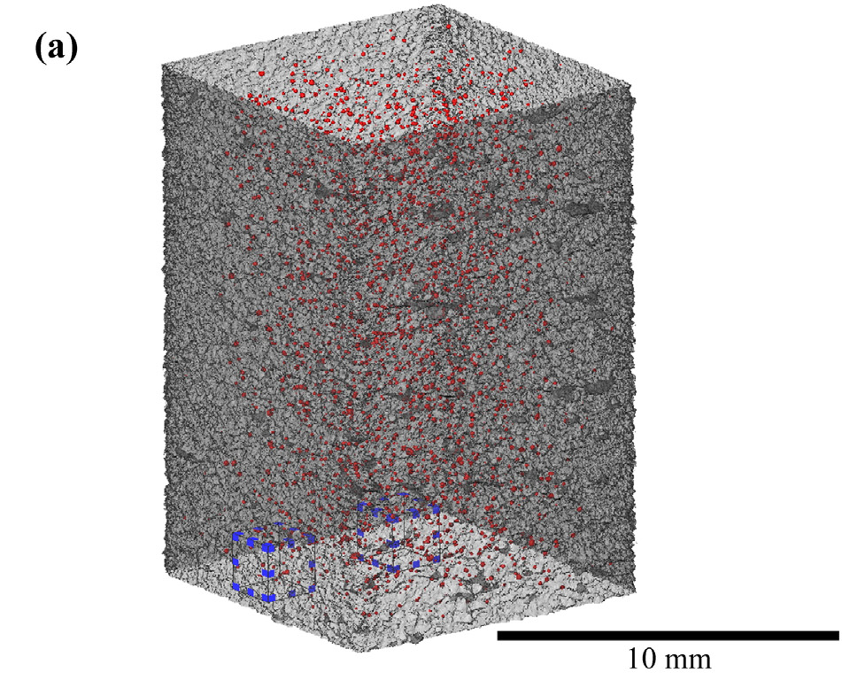
Correlate morphologies

Slide 4
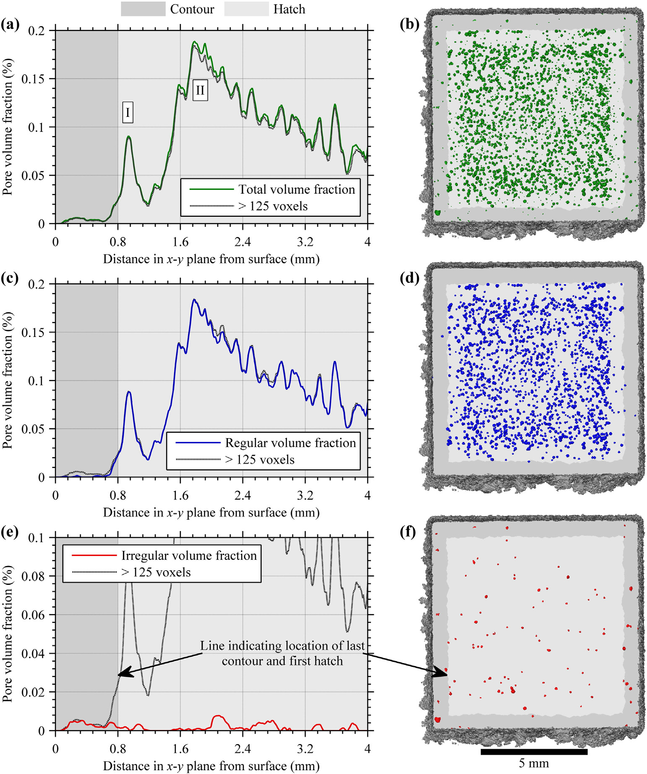
Correlate to manufacturing

Slide 5
Correlate to manufacturing

Slide 6
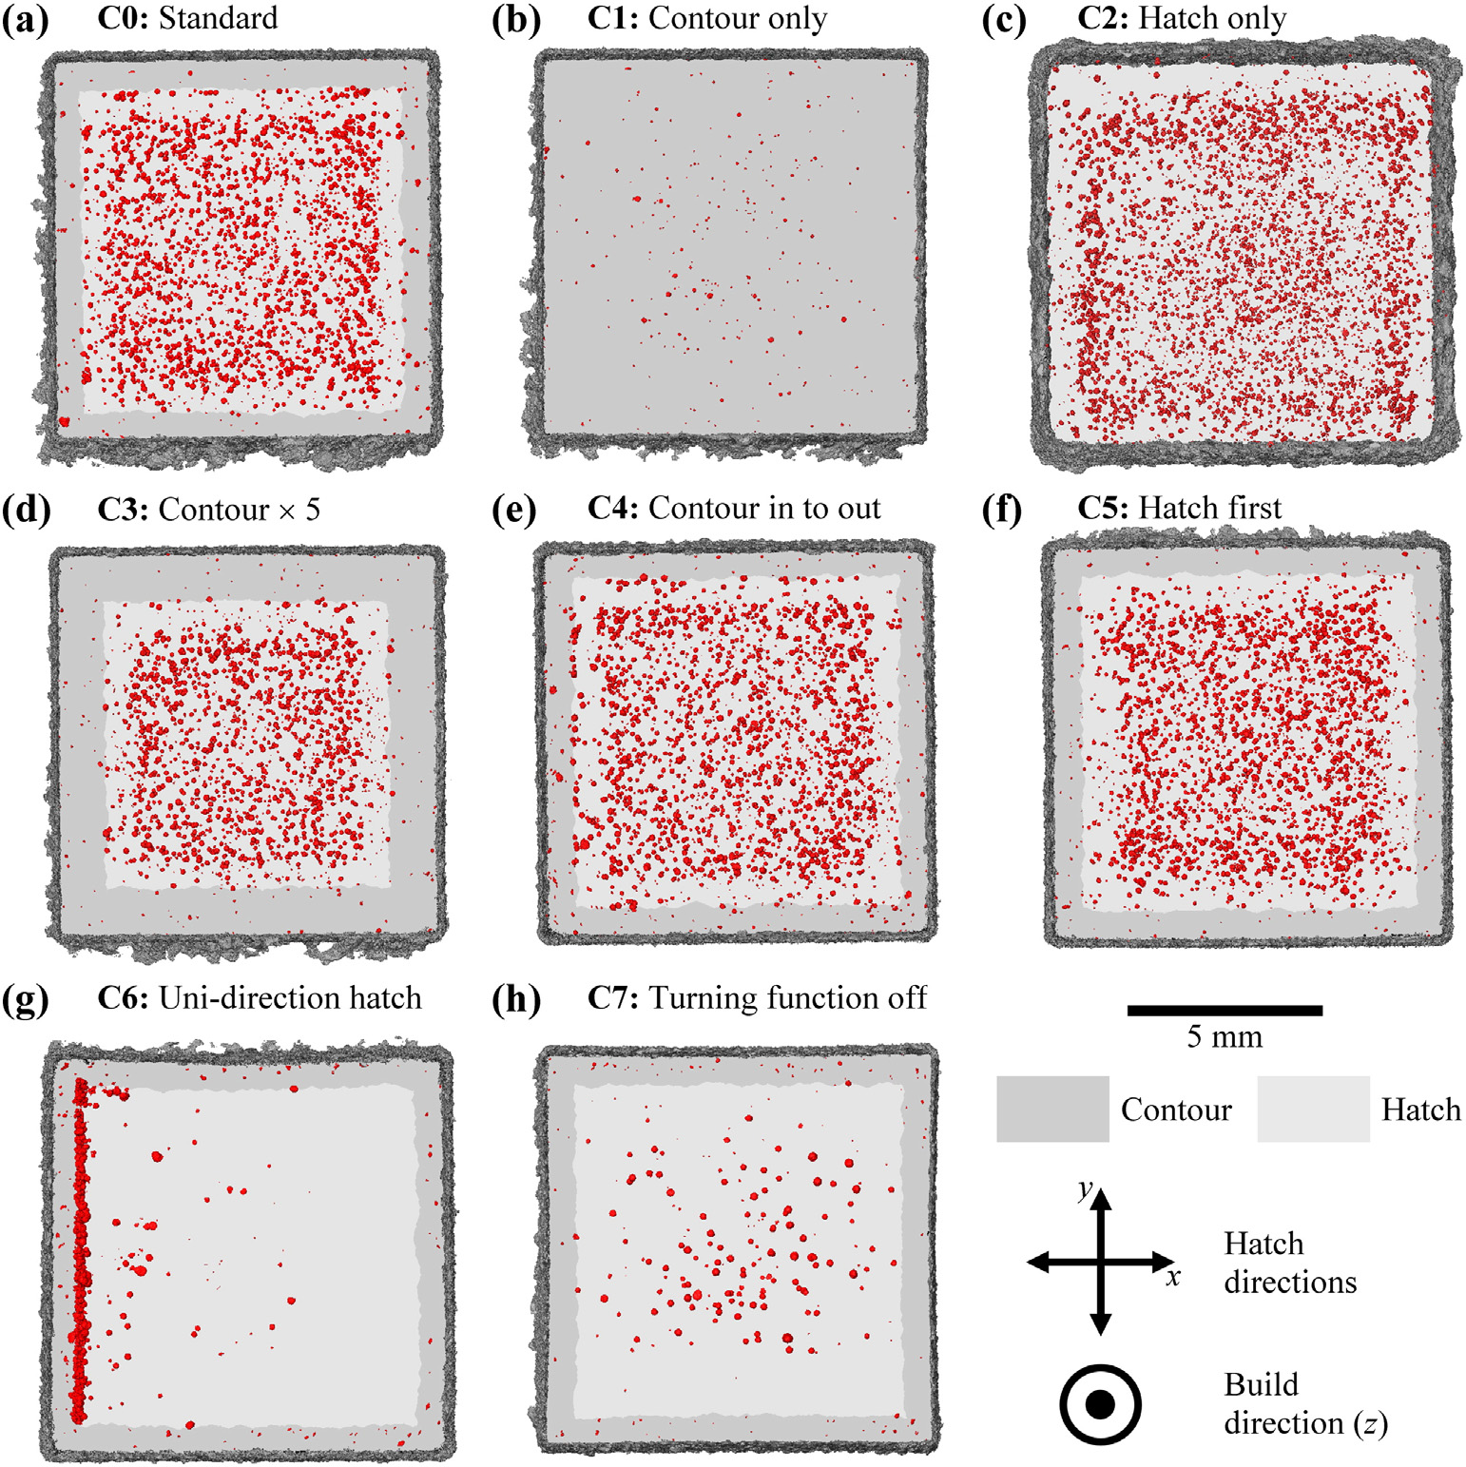
Correlate to strategy

Slide 7
Can we get rid of them post AM?
As-built
HIPed

Slide 8
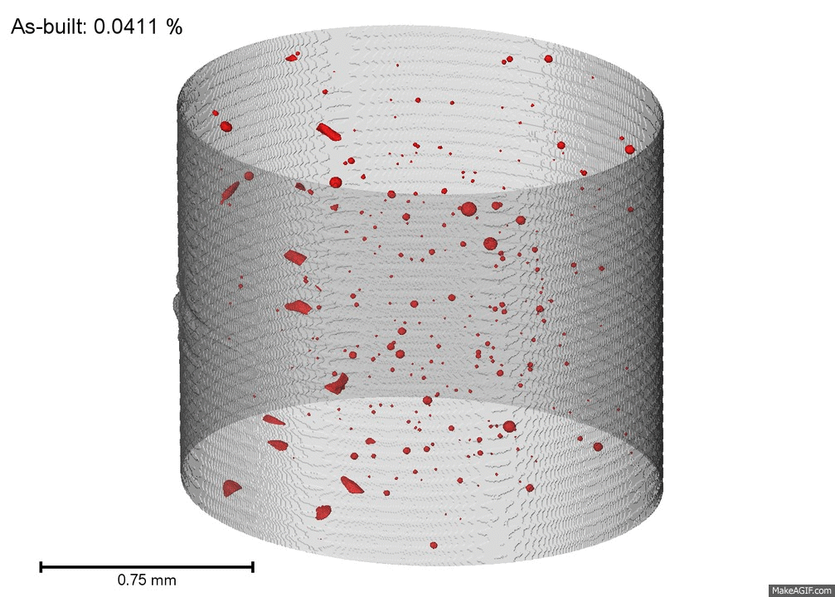
However…
Most pores are caused by argon bubbles

Slide 9
Pores reopen

Slide 10
Correlate sizes

Slide 11
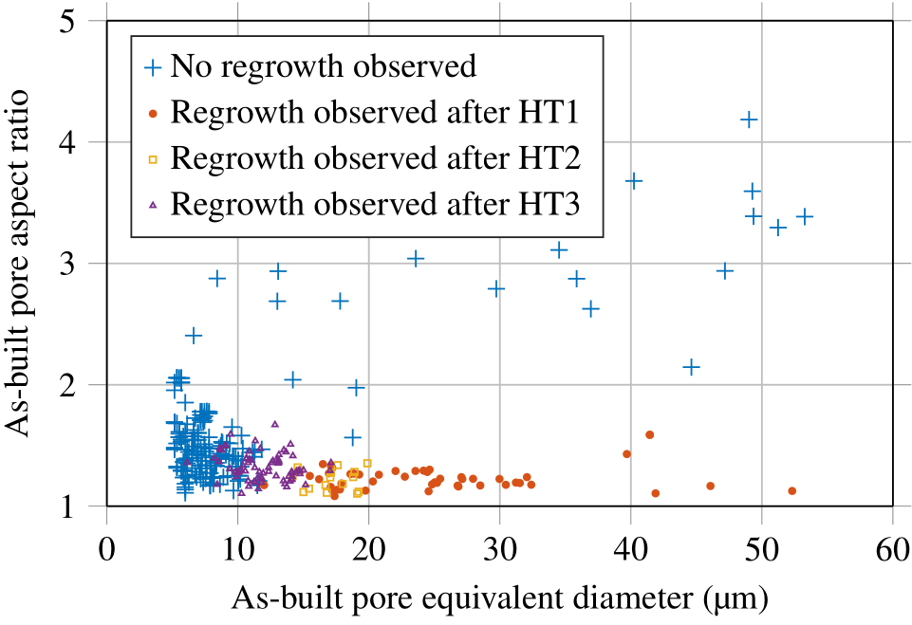
Only gas pores reopen

Slide 12
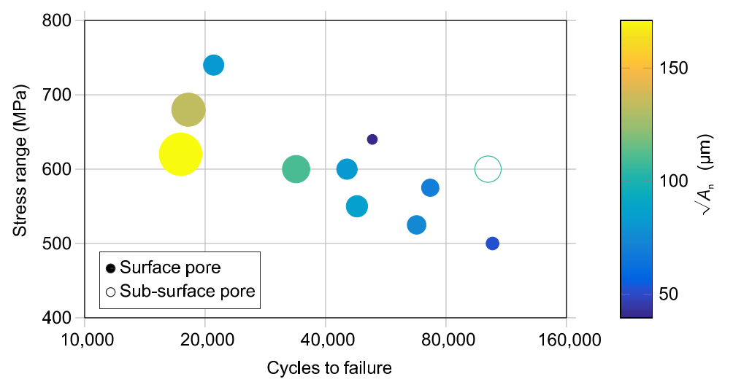
Life against defect size

Slide 13
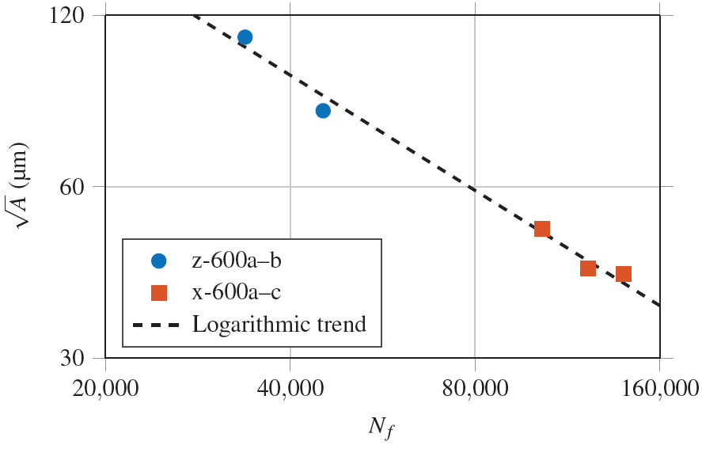
Life against defect size
√A = 10^{5.1(±0.2)} · N_{f} ^{-0.67(±0.04)} R² = 0.99

Slide 14
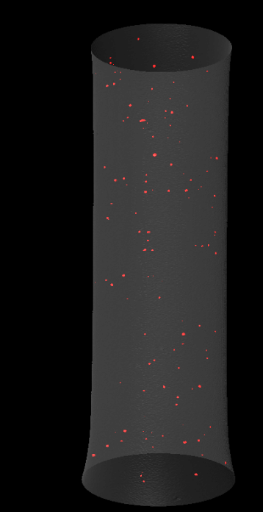
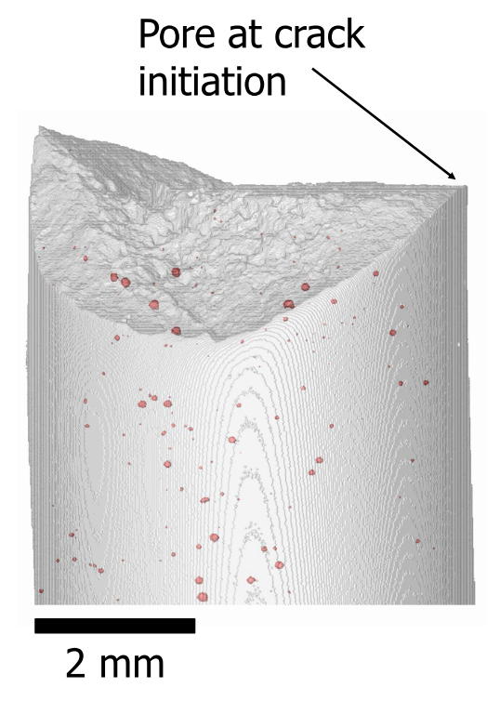
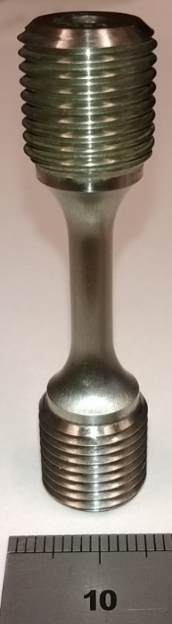
Why this pore?
There are hundreds!
5 mm

Slide 15
Are all pores created equal?

Slide 16
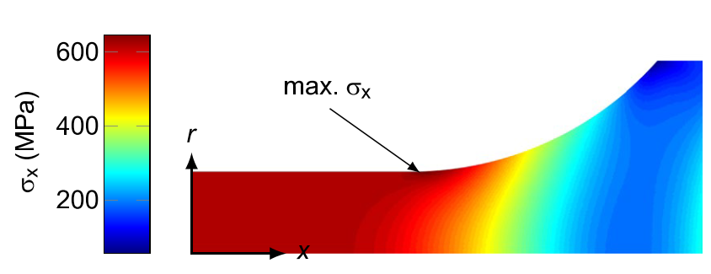
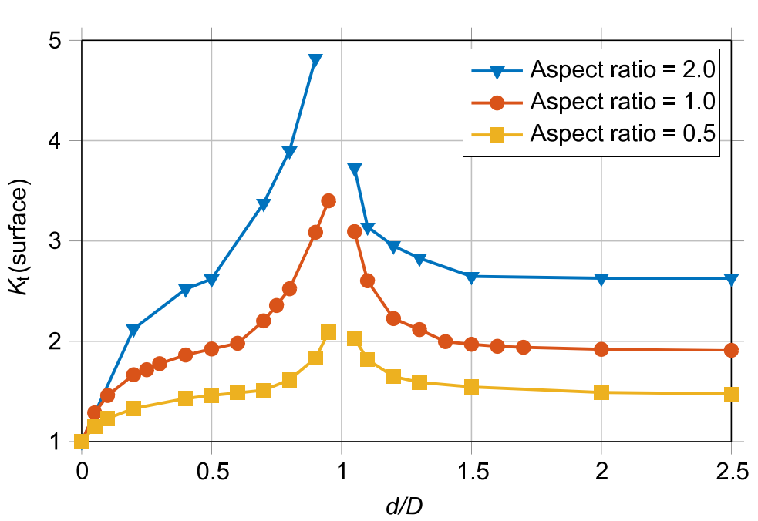
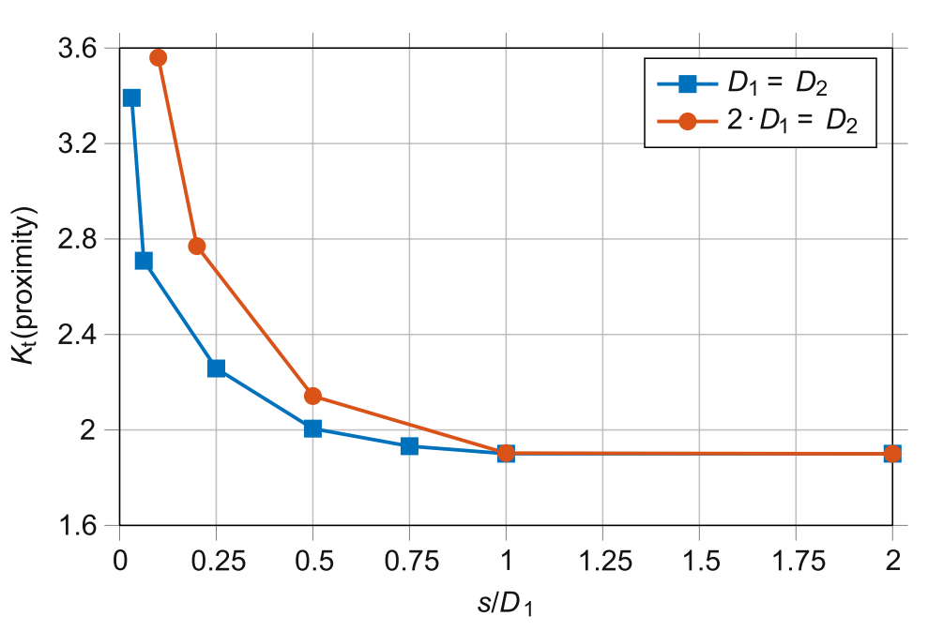
Are all pores created equal?
Simple empirical relationship based on idealised FEM

Slide 17
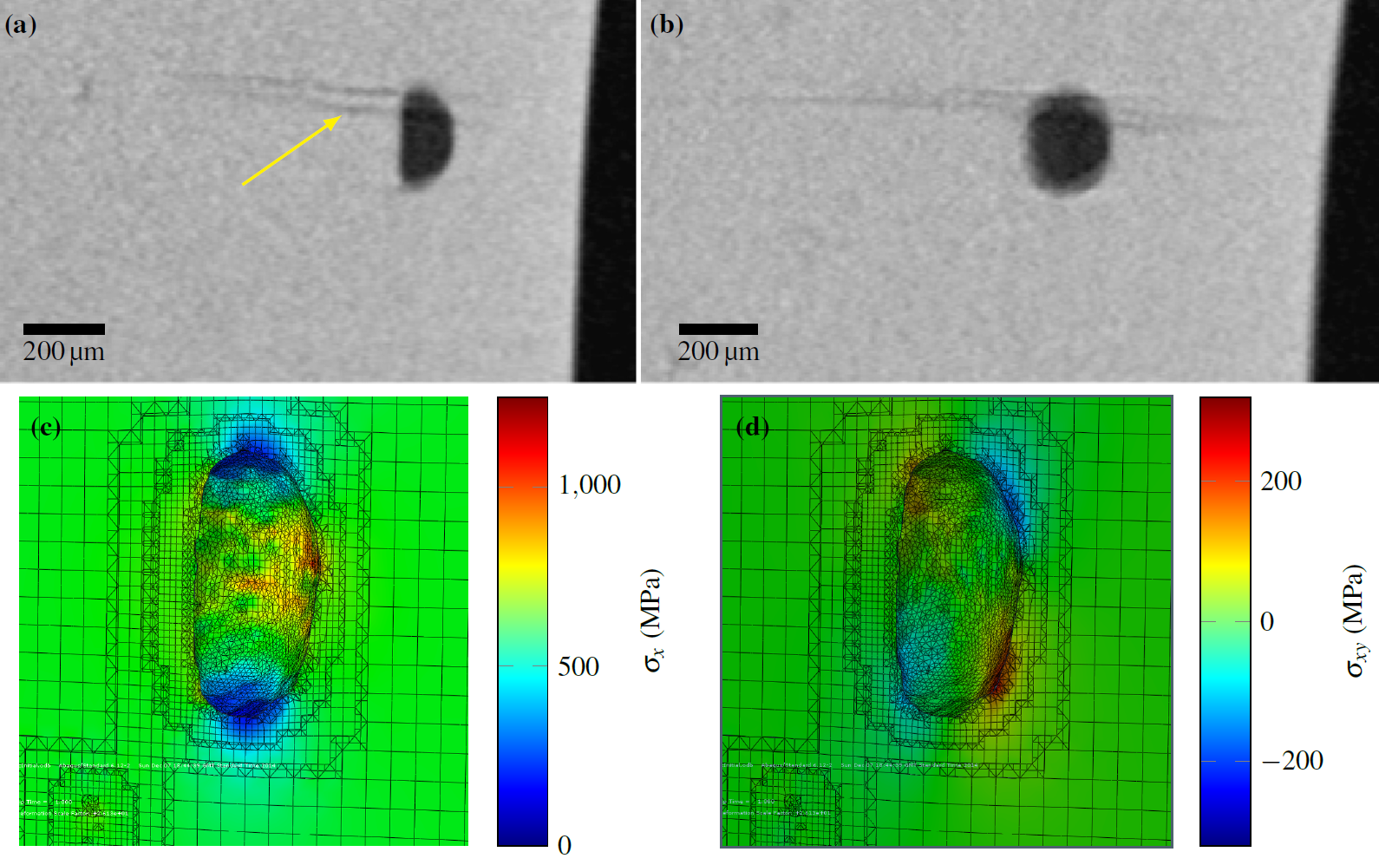
Crack initiation

Slide 18
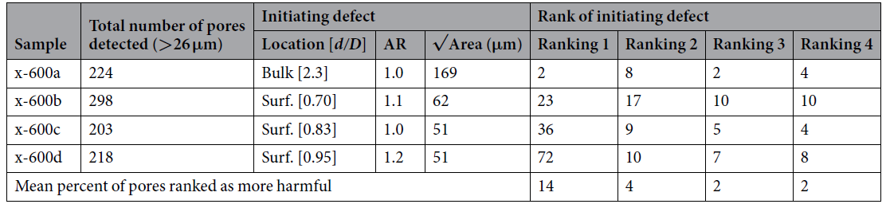
Crack initiation can be predicted

Slide 19
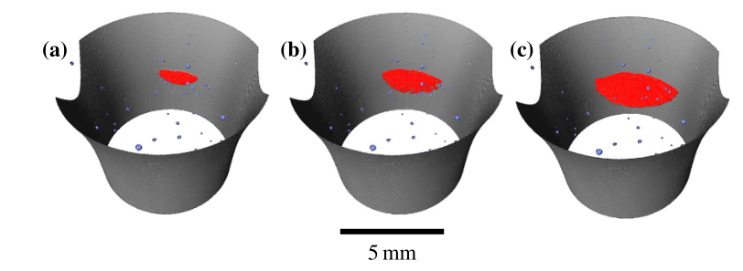
Crack growth imaged by CT
Increasing number of cycles

Slide 20
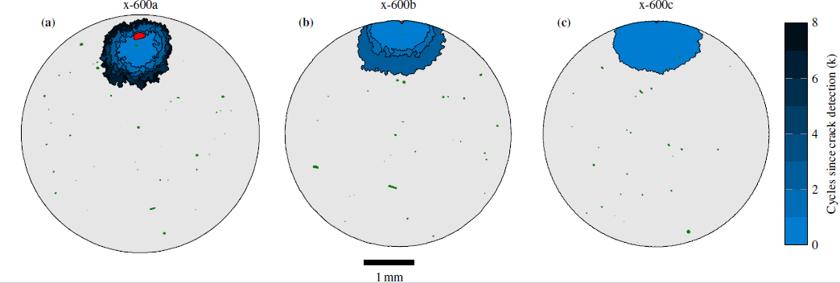
Crack growth imaged by CT

Slide 21
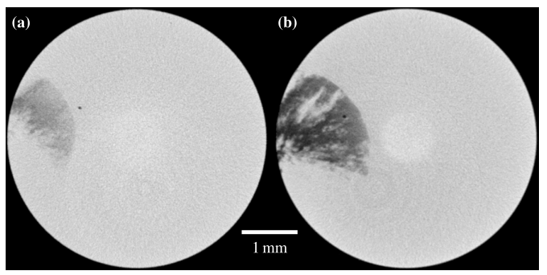
Influence of Pores on Crack Growth Rate
103k Cycles
104k Cycles

Slide 22
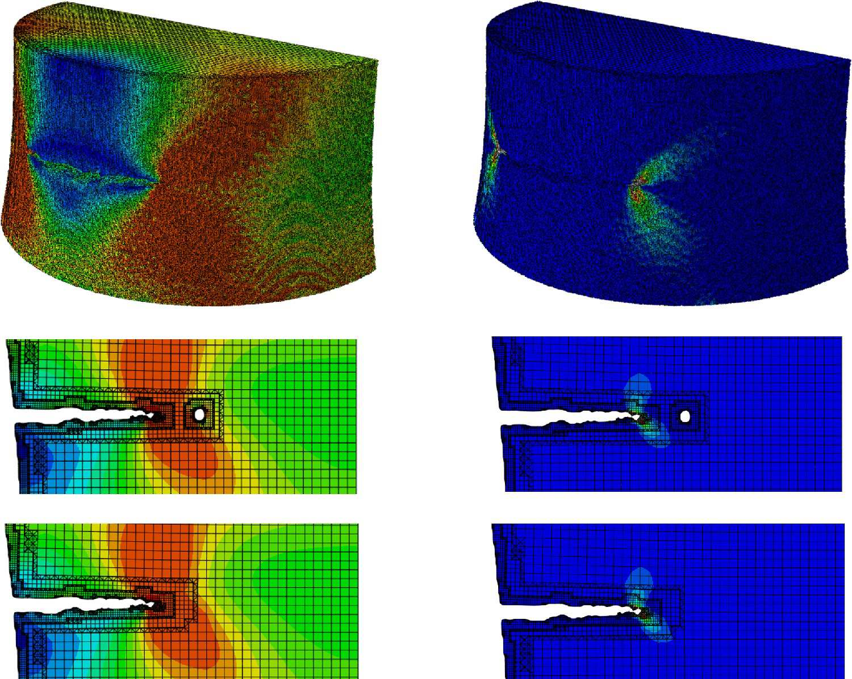
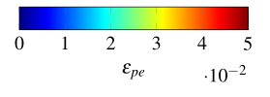
Influence of Pores on Crack Growth Rate
δ < 0.3 %

Slide 23
Can we optimise manufacturing based on what we have learnt?
N_{f} | √A_{n} (µm)
10,000 | 240
20,000 | 150
40,000 | 90
80,000 | 60
160,000 | 40
√A = 10^{5.1(±0.2)} · N_{f} ^{-0.67(±0.04)} R² = 0.99

Slide 24
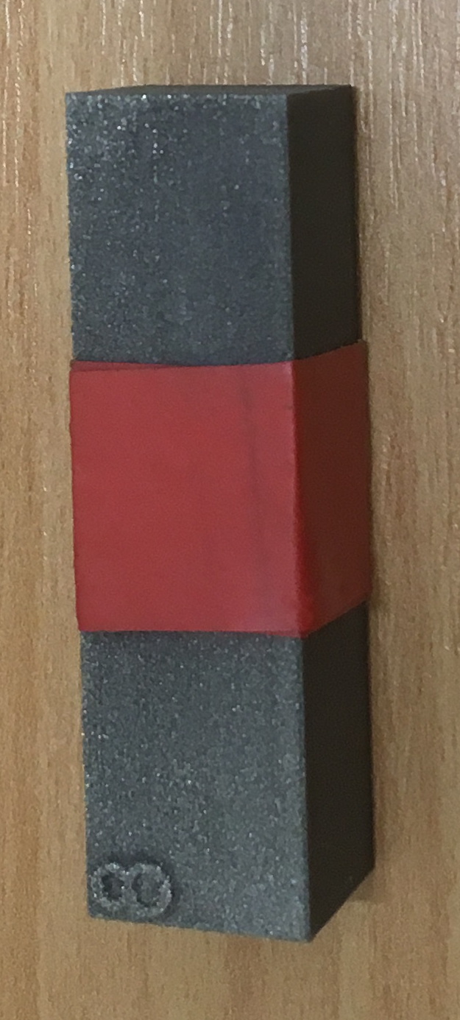
Samples were machined from “bulk” material

Slide 25
Effect of melt strategy on defect population
S. Tammas-Williams, I. Todd, et al., XCT Analysis of the Influence of Melt Strategies on Defect Population in Ti-6Al-4V Components Manufactured by Selective Electron Beam Melting, Mater. Charact. 102 (2015) 47–61. doi:10.1016/j.matchar.2015.02.008.

Slide 26
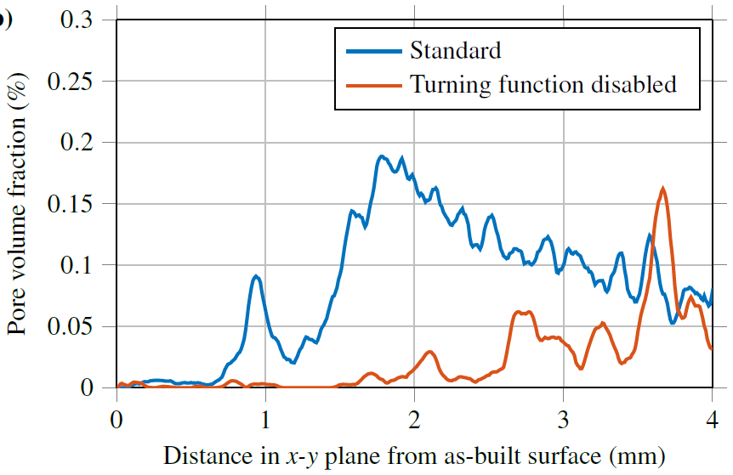
Effect of melt strategy on defect population

Slide 27
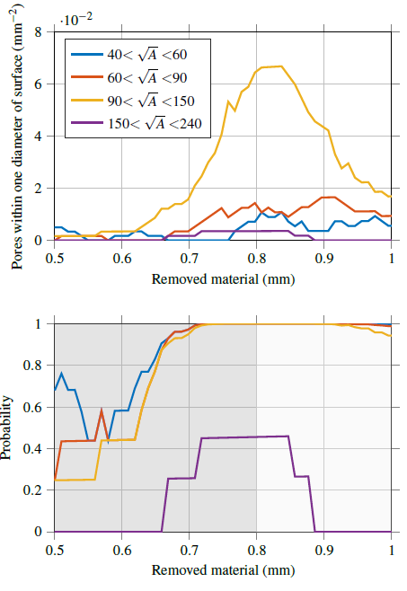

Correlate machining depths to life
P = 1 – e^{-λ}

Slide 28
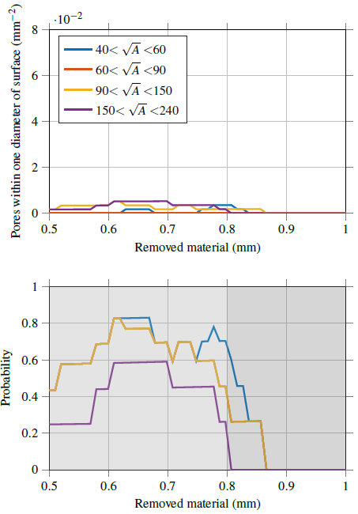
Modify melt + machining strategy
P = 1 – e^{-λ}

Slide 29
Summary and references
S. Tammas-Williams et al., Influence of Porosity on Fatigue Crack Initiation in Additively Manufactured Titanium Components, Sci. Rep. 7 (2017) 7308. doi:10.1038/s41598-017-06504-5
S. Tammas-Williams et al., XCT Analysis of the Influence of Melt Strategies on Defect Population in Ti-6Al-4V Components Manufactured by Selective Electron Beam Melting, Mater. Charact. 102 (2015) 47–61. doi:10.1016/j.matchar.2015.02.008.
S. Tammas-Williams, P.J. Withers, I. Todd, P.B. Prangnell, Porosity regrowth during heat treatment of hot isostatically pressed additively manufactured titanium components, Scr. Mater. 122 (2016) 72–76. doi:10.1016/j.scriptamat.2016.05.002.
S. Tammas-Williams, P.J. Withers, I. Todd, P.B. Prangnell, The Effectiveness of Hot Isostatic Pressing for Closing Porosity in Titanium Parts Manufactured by Selective Electron Beam Melting, Metall. Mater. Trans. A. 47 (2016) 1939–1946. doi:10.1007/s11661-016-3429-3.

