Slide 1
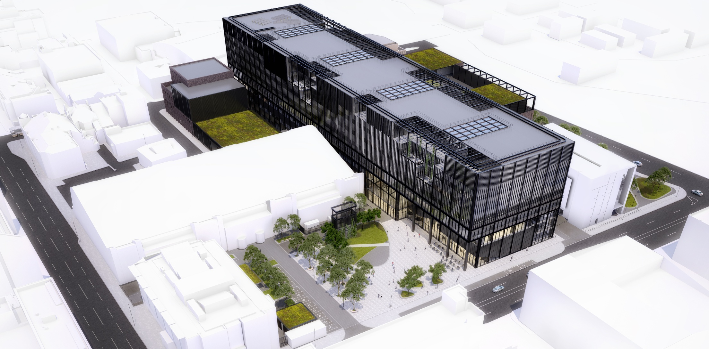
Future enabling technologies for
cognitive computer aided engineering
MECD Building
c
Lee Margetts – University of Manchester
IBFEM, Swansea, 3-6 September 2018

Slide 2
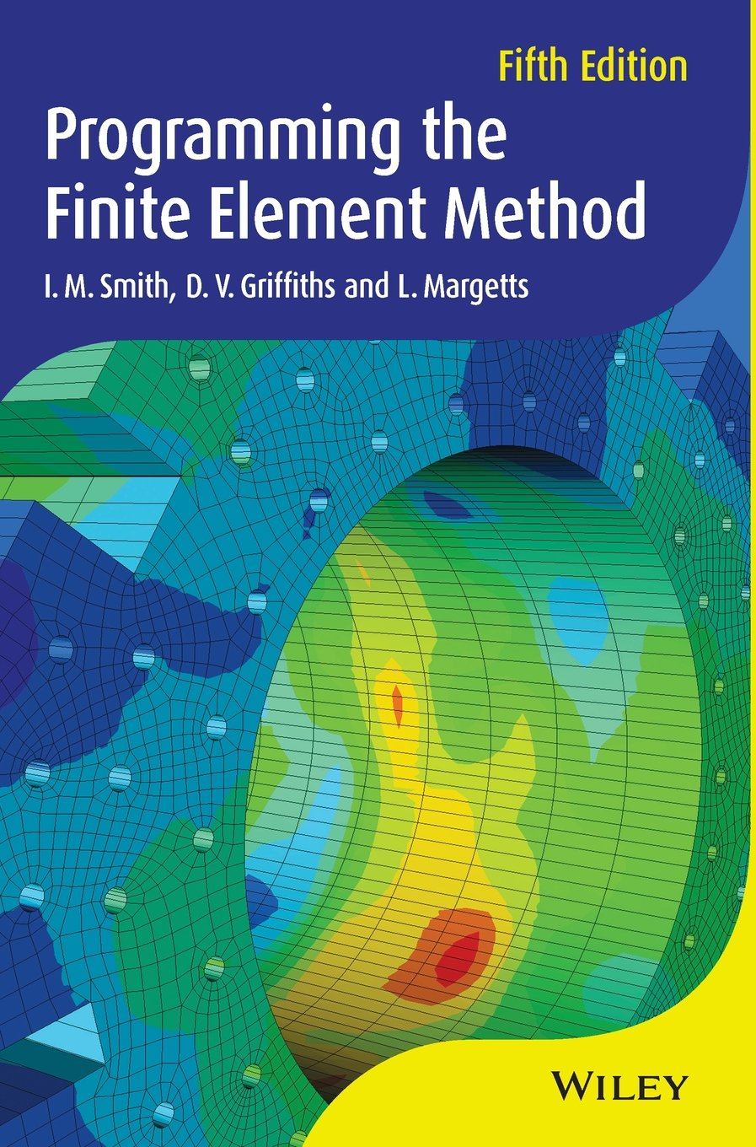
Parallel Finite Element Analysis
ParaFEM
Open source library
~70 mini Apps
ARCHER, SSI & EU PoP
~64,000 cores
>1 billion degrees of freedom
1100 registered users
12,000 downloads of latest version
142,000 visits to website
1300 citations of text book
Notes:
Scalable large scale solid mechanics software is the missing component in a scientific software framework for simulating processes involving multiple length scales and coupled physics processes. The Fellowship will nudge the ParaFEM project into the Snowball stage of open source projects.

Slide 3
Lifecycle of Open Source Projects
Phase I
Project
Initiation
Phase II
Incubation Stage
Phase III
Snowball Stage
Phase IV
Emergent
Markets
Phase V
Wealth Generation
Firm A
Services
Training
user curve
Customize for own use
Bandwagon
Network building
Firm B
Complementary
products
Challenging project
Opportunity
scanning
User-developers
Ease of use
Firm C
Services
Consultancy
developer curve
User-developer
Developer
User
Margetts L, “Wealth generation from open source software”, MBA Dissertation, Alliance Manchester Business School, 2011
Notes:
Scalable large scale solid mechanics software is the missing component in a scientific software framework for simulating processes involving multiple length scales and coupled physics processes. The Fellowship will nudge the ParaFEM project into the Snowball stage of open source projects.

Slide 4
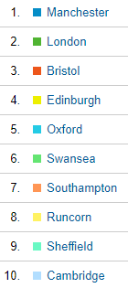
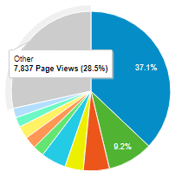
Community Co-development
% Page Views by City
142,000 views
http://parafem.org.uk
Notes:
ParaFEM project has grown organically. Now too successful to be managed effectively and supported on a voluntary basis. Fellowship will enable me to consolidate what has already been achieved, then by improving code quality and usability, the user and co-developer community can grow.

Slide 5
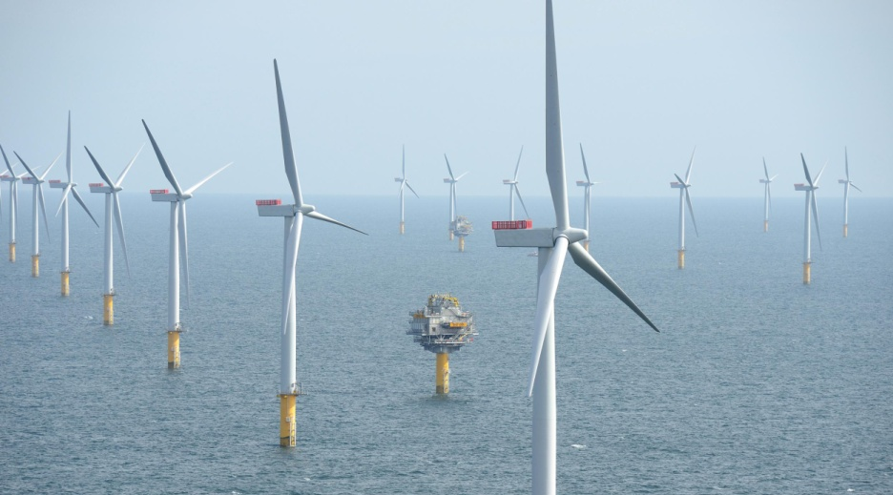
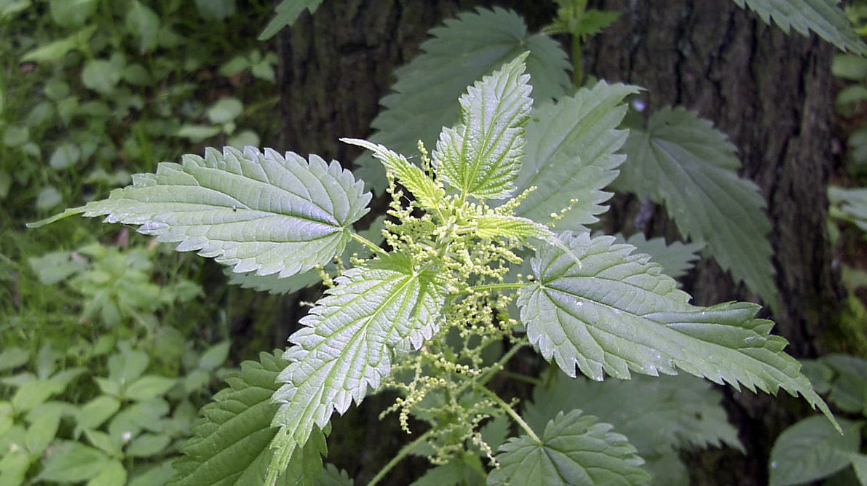
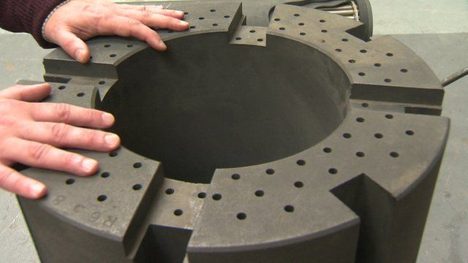
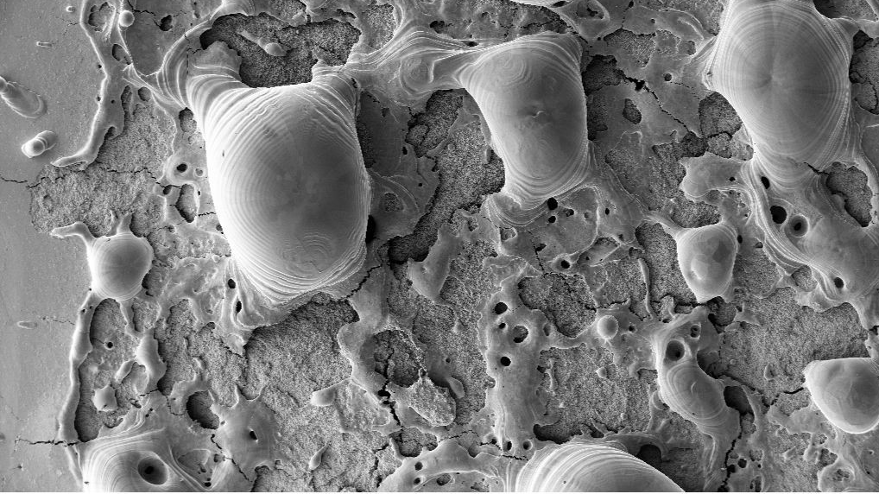
Science Driven
Wind Energy – Fluid Structure Interaction
Recyclable Aerospace Composites – UELs
Margetts L, “Wealth generation from open source software”, MBA Dissertation, Alliance Manchester Business School, 2011
Nuclear Graphite – Monte Carlo Simulation
Fusion Materials – Image-based Modelling
Notes:
Scalable large scale solid mechanics software is the missing component in a scientific software framework for simulating processes involving multiple length scales and coupled physics processes. The Fellowship will nudge the ParaFEM project into the Snowball stage of open source projects.

Slide 6
Random field generator
OpenFOAM FSI
ParaView Viz
Cellular Automata
ParaFEM Open Source Library
Solvers
Maths libraries
MPI
OpenMP
GPUs
Xeon Phi
ARM
Cloud
ABAQUS
UMAT/UEL
ENSIGHT

Slide 7
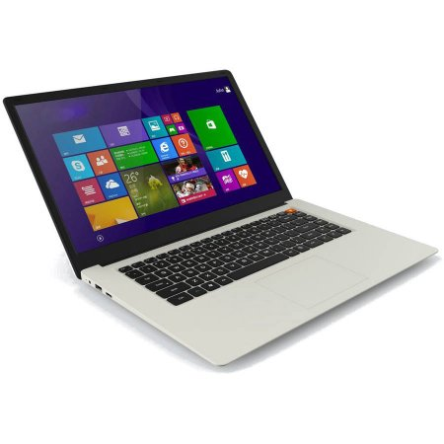
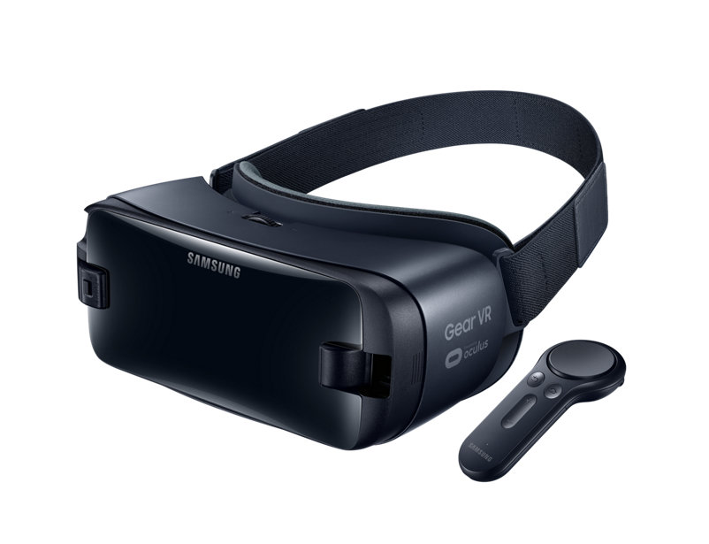
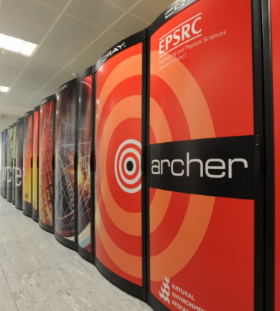
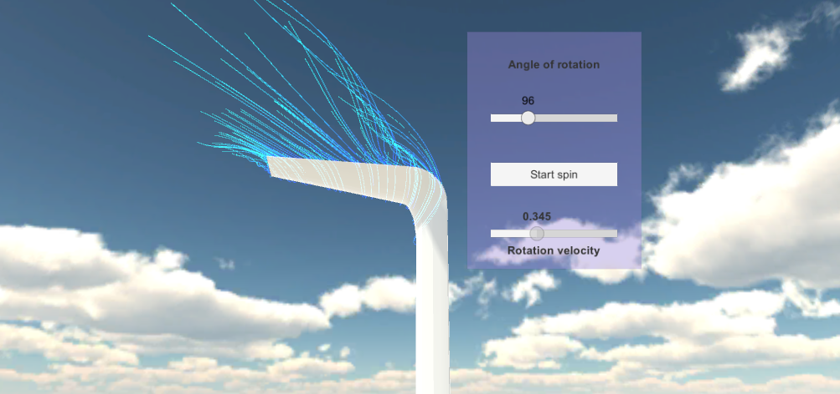
Virtual Reality for Visualisation
(a) Simulation (b) Post-processing (c) Android app (d) Viewer
3-4 Undergraduate and MSc project students per year investigating use of commodity VR
Seu, Hewitt & Margetts (2018), “Use of gaming and affordable VR technology for the visualisation of complex flow fields”, 6th European Conference on Computational Mechanics (ECCM 6), 7th European Conference on Computational Fluid Dynamics (ECFD 7), Glasgow, UK

Slide 8
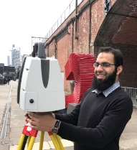
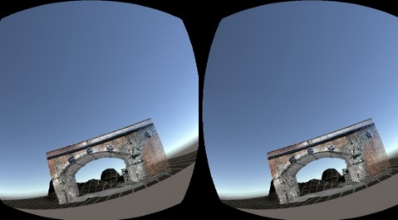
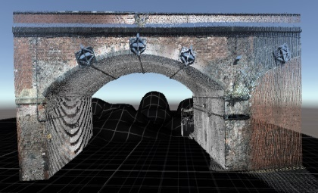
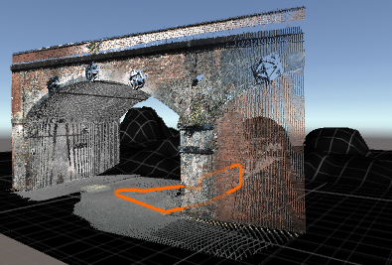
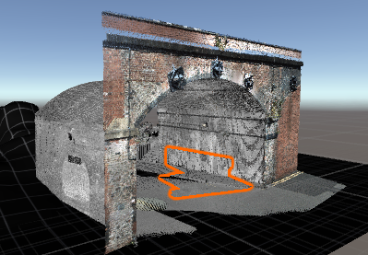
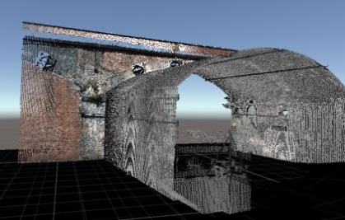
Virtual Reality for Inspection
(a) Measurement (b) Post-processing (c) Android app (d) Viewer
Omer, Hewitt, Margetts, Hadi Mosleh and Parwaiz (2018), “Performance evaluation of bridges using virtual reality”, 6th European Conference on Computational Mechanics (ECCM 6), 7th European Conference on Computational Fluid Dynamics (ECFD 7), Glasgow, UK

Slide 9
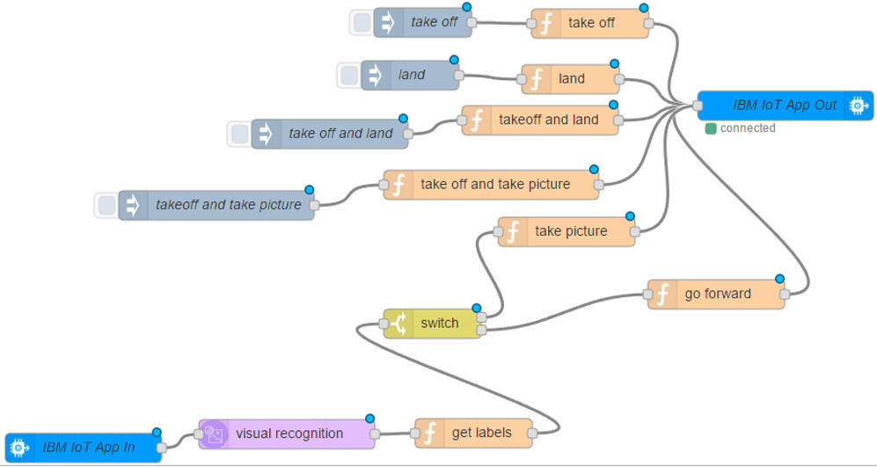
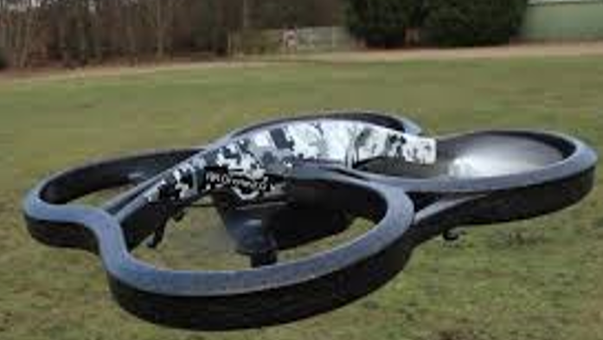
Image Recognition
c
Syed Abidi, “Cognitive Computing in Drones”, BSc Final Year Project, 2017

Slide 10
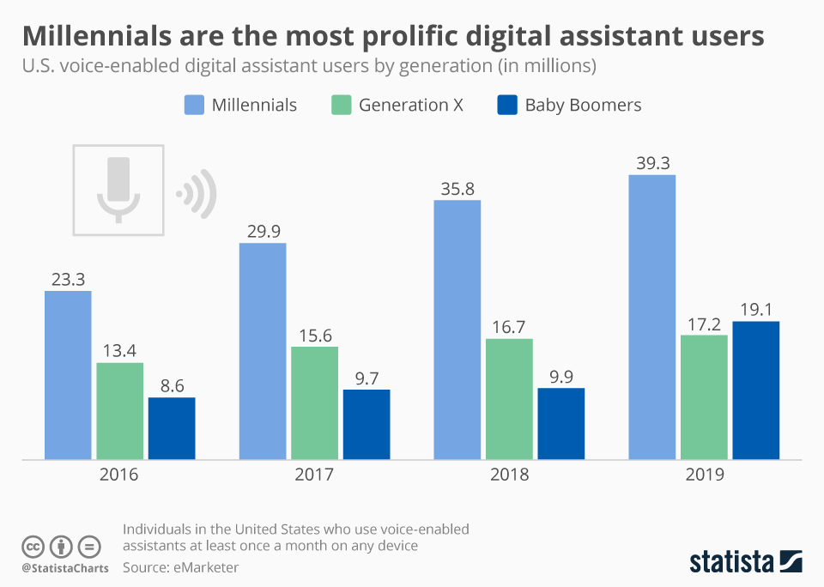
“Sorry I can’t do that Dave”
BSc Final Year Project (2018-19) will review open source libraries for voice recognition and assess them for CAE.
Menu driven CAE packages are increasingly feature rich and densely populated. Could voice be used to assign materials, set meshing parameters and run jobs?

Slide 11
Machine Learning
A core objective of a learner is to generalize from its experience. Generalization in this context is the ability of a learning machine to perform accurately on new, unseen examples/tasks after having experienced a learning data set. The learner has to build a general model about this space that enables it to produce sufficiently accurate predictions in new cases
Neural Networks Find patterns in data.
Deep Learning Multiple layers of neural networks.
Reinforcement Learning Maximize long-term reward.
Genetic Algorithms Mutation and cross-over.
Rule-based ML Identifies and evolves rules.

Slide 12
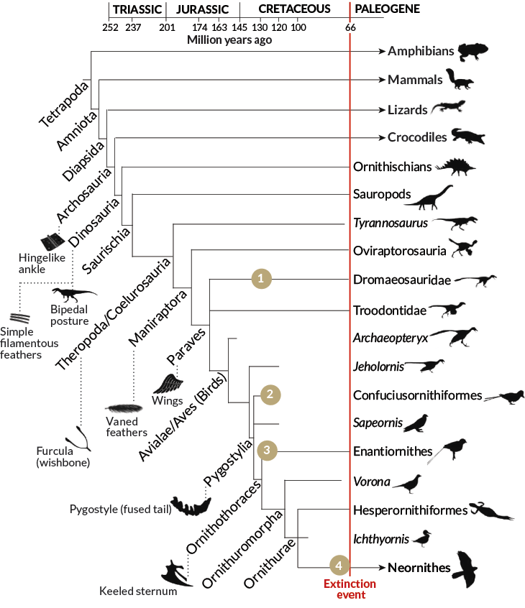
AI in Simulation Tools
Literature survey shows a long history of attempts to use AI in simulation tools
Two examples of neural networks: Load-displacement response and calibrating constitutive models of materials
Most reached dead ends due to lack of computer resources (memory, storage, processing)
Now AI is mainstream with pay as you go Cloud resources

Slide 13
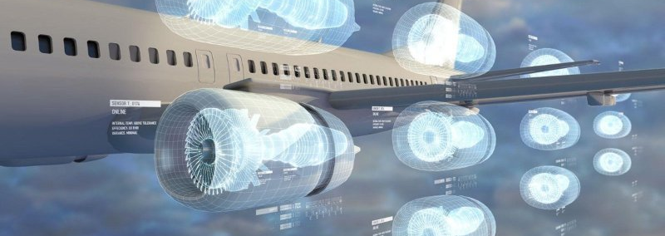
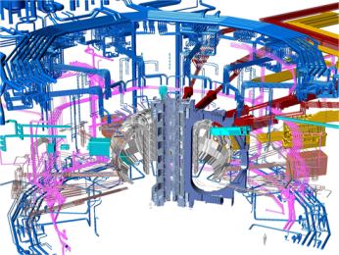
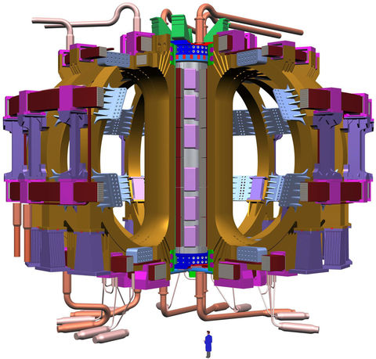
Digital Twins
Performance of insilico aircraft under virtual flight conditions.
Cognitive computing to supervise the set up and deployment of simulation.
Making digital twins a practical reality needs research into “cognitive CAE”.
Notes:
The benefits are that we will be able to enter a new era of engineering. The vision is to be able to develop digital twins of complex engineering systems. We will model whole aircraft virtual flight. Whole wind farm.

Slide 14
National Priorities
Future enabling technologies for
cognitive computer aided engineering
Contributing to RSE development
Supporting EPSRC’s Tier 2, Tier 1 and Tier 0 users
Notes:
And finally, do I have the leadership skills to be an RSE Fellow? I hope so! I spent a lot of money on an MBA! I have held a number of leadership roles.

